Slide 1

Metabolic interactions and capabilities within microbial communities
Dissertation Defense
Gregory Medlock
Advisor: Jason Papin, PhD
Committee: Kevin Janes, PhD (Chair)
Peter Kasson, MD, PhD
Mete Civelek, PhD
William Petri, MD, PhD

Slide 2
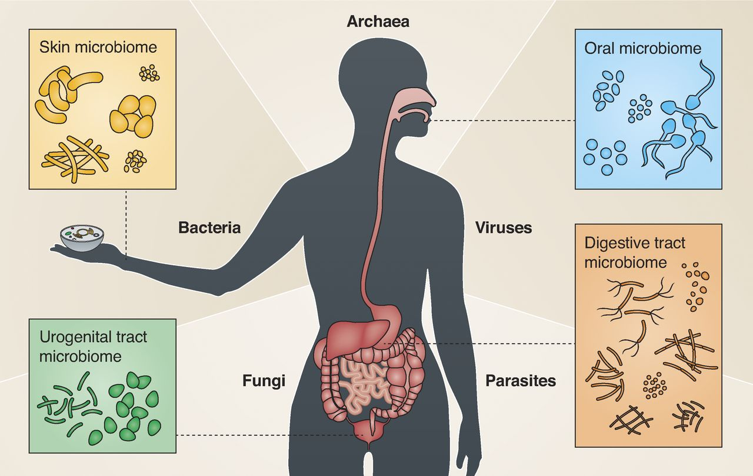
Microbes cause diseases ...
Microbes enable:
Immune system development
Digestion
Protection from infectious diseases
Together, the host and microbes are a microbiome. All of the strains of microbial organisms inhabiting a host are the microbiota.
... yet are essential for human life
Image: Garrett, JCB 2015
Background | Aim 1: metabolic interactions | Aim 2: metabolic capabilities | Conclusions
Notes:
We’ve appreciated for some time now that microbes cause diseases in humans. However, we aremore recently coming to appreciate that they are also essential for human life. All of the surfaces of the human body are teeming with microbial life, which enable development of our immune systems, improve digestion, and protect us from infectious diseases.
Together, the human “host”, the microbes that occupy them, and all of the environmental factors they share, are known as a microbiome. Within a microbiome, all of the microbial organisms inhabiting the host are known as the microbiota.

Slide 3
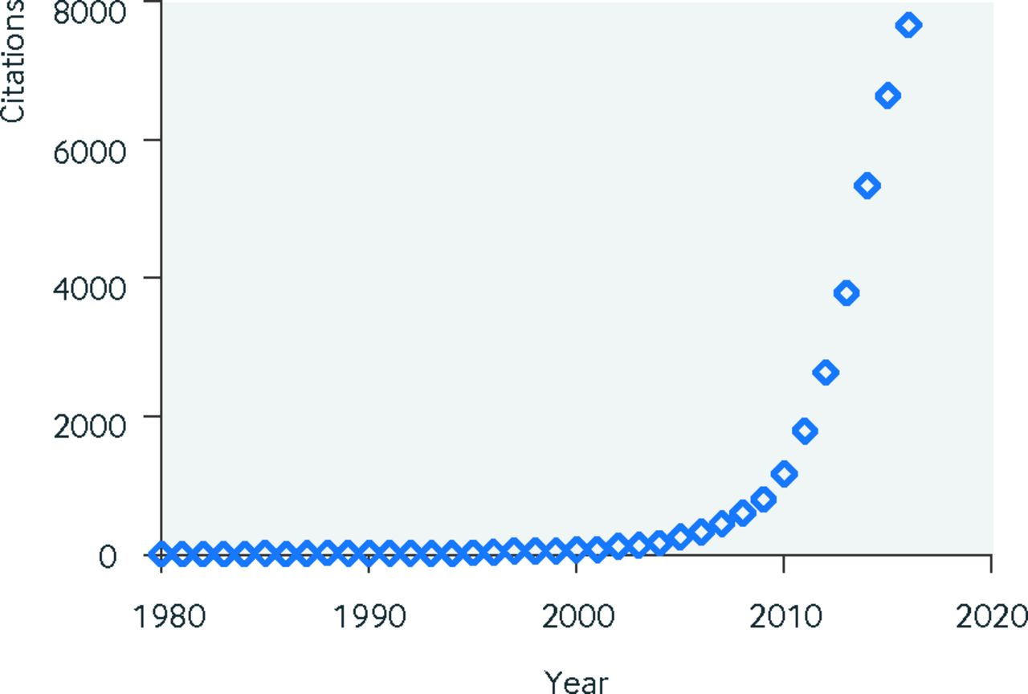
Exponential growth of microbiome research
1980s: regions of conserved genes used to identify bacterial species
Idea:
All bacteria need this gene; evolution introduces small changes.
2003: Human genome project completed.
Enabled cheap & rapid DNA sequencing for microbes, too.
Human genome
project completed
# of publications
“marker” genes
discovered
Year
Image: Young, BMJ 2017
Background | Aim 1: metabolic interactions | Aim 2: metabolic capabilities | Conclusions
Notes:
Microbiome research has exploded in popularity recently—this plot describes the number of scientific publications with the keyword “Microbiome” over time. This recent growth was enabled by two independent areas of research.
The first was work on marker genes throughout the 80s. Researchers in microbial ecology were trying to find DNA sequences that they could use to easily discriminate between species of bacteria. The idea was that if there was a common gene that all bacteria needed, then they could find portions of that gene that were flexible in their sequence. During evolution, small changes were introduced to genes like this, which enabled discrimination of bacterial species based on their specific sequence of DNA in this gene. Today, the 16S rRNA gene is used most often for this kind of study.
The other key work required to enable microbiome researcher was catalyzed by the human genome project, which was declared complete in 2003. DNA sequencing technology experienced extremely rapid development during this period, which also enabled inexpensive, high-throughput sequencing for bacteria.

Slide 4
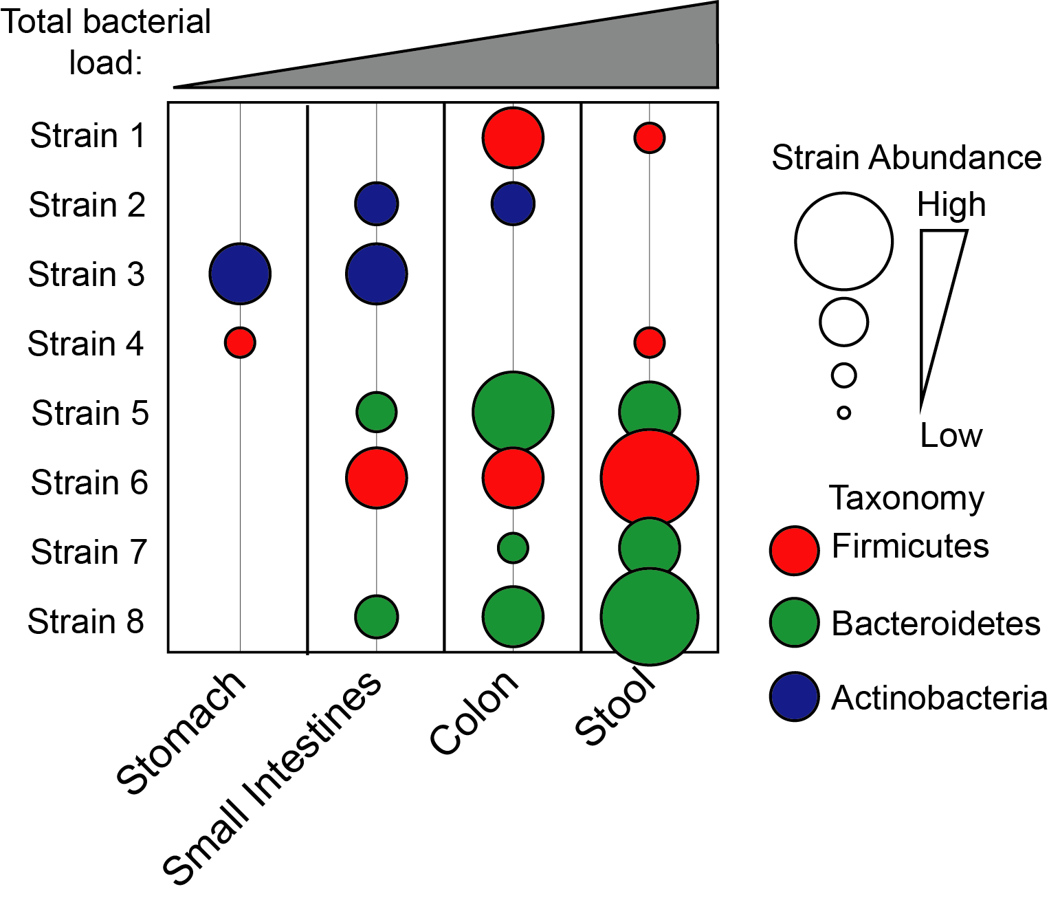
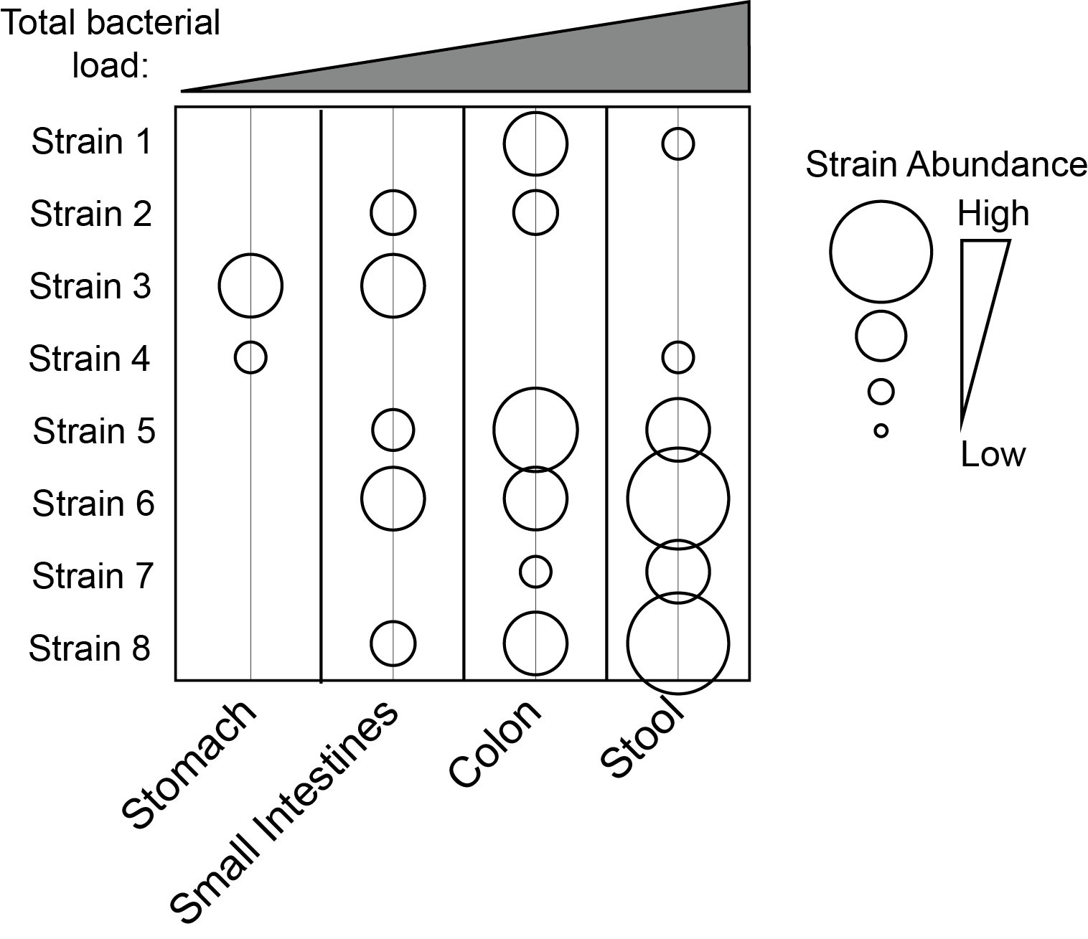
Inexpensive DNA sequencing enabled microbiome profiling
Microbiome-disease associations identified:
Irritable bowel disease
Obesity
Anxiety
Colon cancer
Infectious diseases
Why are gut microbes so frequently associated with disease?
Background | Aim 1: metabolic interactions | Aim 2: metabolic capabilities | Conclusions
Notes:
Together, this research enabled the microbiome profiling that has led to exponential growth of the field. The methods developed by microbiome researchers allow sampling of human body sites, followed by sequencing of marker genes, and the subsequent identification of unique sequences from these data and quantification of each sequence in each sample.
Additionally, the properties of marker genes and evidence of evolution that they hold allow each of the sequences detected to be assigned taxonomic identity. This enables researchers to identify potential conserved trends between specific groups of related bacteria and their lifestyle with the host.
Thanks to these profiling approaches, we’ve discovered associations between the abundance of particular strains of bacteria in the gut with diseases inclduing IBD obesity, anxiety,colon cancer, and infectious diseases. This raises the question, why are gut microbes so frequently associated with diseases?

Slide 5
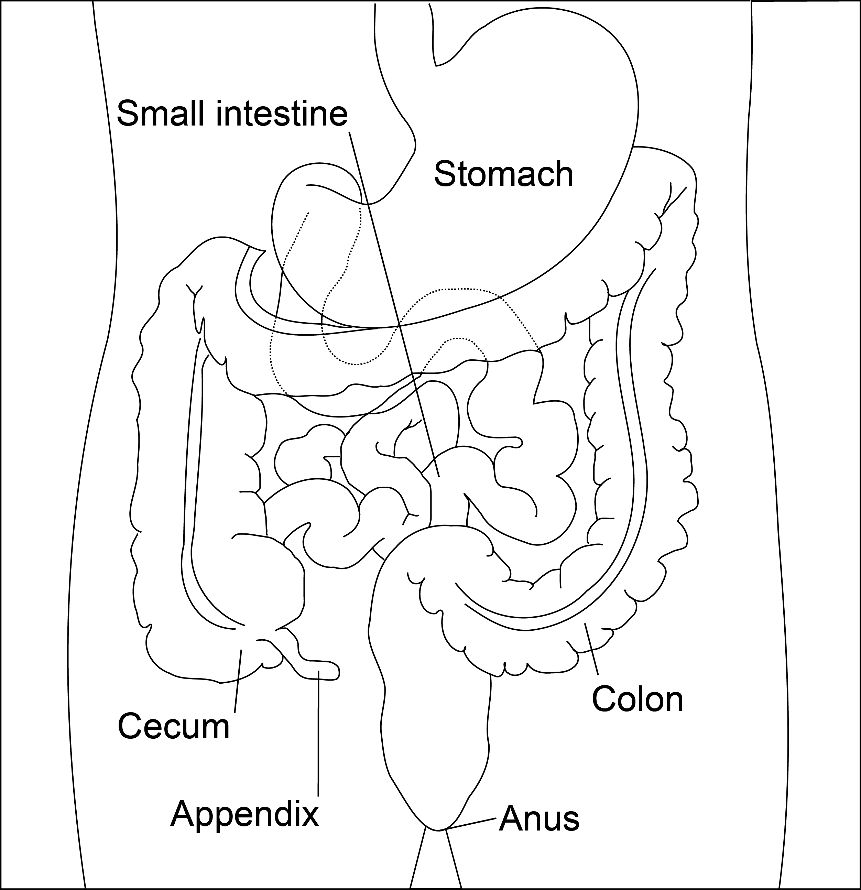
Why are gut microbes associated with disease?
Gut: exposed environment to extract energy from food, which brings...
Enemies: pathogens causing food poisoning, diarrheal diseases, etc.
Bystanders: going for a ride
Friends: help us fight pathogens, digest food, prevent cancer
Image: Wikipedia
Background | Aim 1: metabolic interactions | Aim 2: metabolic capabilities | Conclusions
Notes:
One part of this complicated question can be attributed to the difficult role the gut plays for humans. In order to absorb nutrients from the environment, the tissue in the gut needs to be partially exposed to the environment. Combine this with the warmth of humans and the abundance of nutrients they are delivering to their gut, and you have a recipe for microbial growth.
As a result, many microbes have evolved functions that make them our enemies—they adopt pathogenic lifestyles, causing infections and diarrheal diseases.
Other microbes have adapted to our gut in ways that benfit us—fighting those same pathogens, helping us digest food, and preventing more complex disease like cancer.
Still, others are just along for the ride, exerting no detectable effect on us.
All microbes exist along this axis of host benefit or detriment, and modern sequencing technologies have helped us identify many of these relationships.

Slide 6
If the microbiota is associated with disease, can we treat disease by manipulating the microbiota?
Probiotics: Estimated revenue of $49 Billion
Mostly food products, unregulated dietary supplements.
But, existing probiotics have limited efficacy.
Why aren’t probiotic drugs more successful?
Background | Aim 1: metabolic interactions | Aim 2: metabolic capabilities | Conclusions
Notes:
So, if the microbiota is associated with disease, can we treat disease by manipulating the microbiota?
Probiotics are one example of this, live microbes that are delivered to humans for some benefit to their health. In 2018, there was an estimated 49 billion in revenue for products marketed as probiotics.
However, this mostly included fermented food products and unregulated dietary supplements with limited evidence of efficacy.
Given the assocaitions we’ve identified between microbes within our microbiome and disease, why aren’t probiotic drugs more successful?

Slide 7
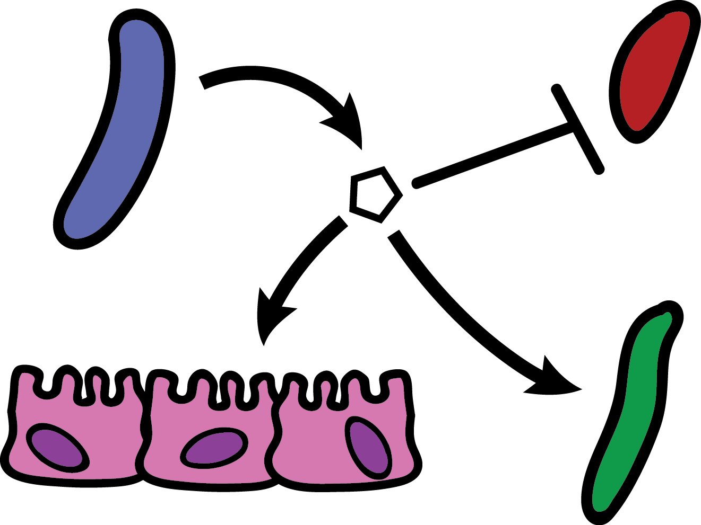
What determines microbiome function?
Interspecies interactions (host-microbe and microbe-microbe)
Interactions can be inferred by measuring population sizes and identifying correlations...
To design effective microbiome therapies, we need to determine the mechanisms governing these interactions.
Background | Aim 1: metabolic interactions | Aim 2: metabolic capabilities | Conclusions
Notes:
One answer is that microbiome function is very complex. Even though we know the species that might be associated with a disease, they live in a more complex environment than we can currently understand.
Microbiome function is made up of networks of interspecies interactions—host-microbe and microbe-microbe interactions, specifically. These interactions include things like physical contact between, competition for metabolites in the environment, and secretion of harmful metabolites by some species.
The presence or absence of an interaction can be inferred by measuring population sizes of bacteria and identifying correlations between the abundance of different strains and/or with a host disease phenotype.
What impedes our ability to go from microbiome-disease association studies to functional therapies is that we lack methods for determining the mechanisms that underlie these interactions or associations.

Slide 8
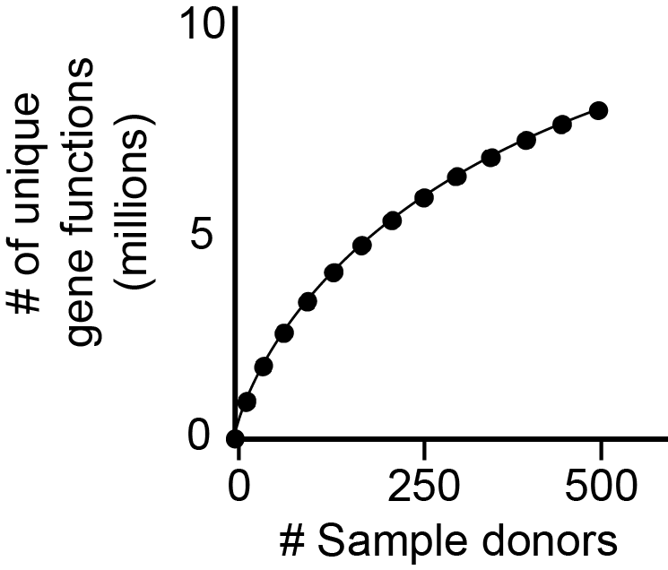
The functions performed by gut microbes are vast and largely unknown
>10 million unique genes
Only ~20-40% with known function
To design effective microbiome therapies, we need to determine the functions carried out by individual gut microbes
Qin et al., Nature 2010 & Lloyd-Price et al., Nature 2017
Background | Aim 1: metabolic interactions | Aim 2: metabolic capabilities | Conclusions
Notes:
The other factor preventing the effective design of microbiome therapies is that even when we identify an assocaiton with a specific microbe, we don’t understand the physiology of that species well enough to manipulate it.
To understand the problem, we can think in terms of the total genetic content in a microbiota and the functions those genes encode. If you sequence all of the DNA in stool from human donors, even just a few hundred humans contain millions of unique microbial genes with unique functions. Across the tnrie human population, there are likely more than 10 million unique genes in their collective microbiome.
Although this may seem daunting, the more daunting observation is that only 20-40% of the genes in any given human microbiome are of known function.
This critical gap in our understanding of gut microbial physiology needs to be overcome if we want to be able to manipulate gut microbes that are part of a disease association.

Slide 9
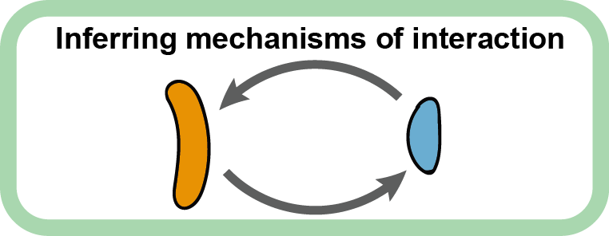
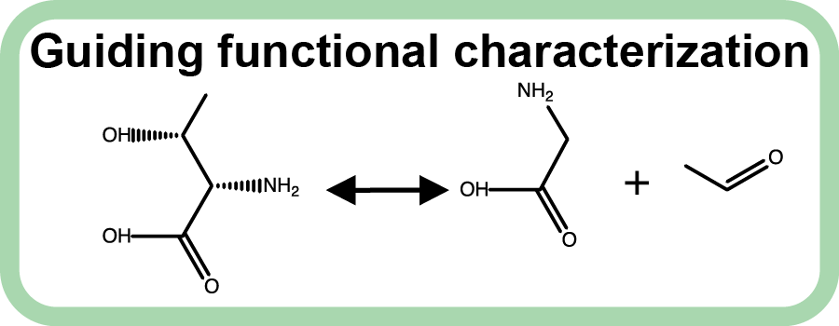
Knowledge gaps preventing treatment of microbiome-associated diseases:
Figuring out mechanisms of association is difficult.
Aim 1: inferring metabolic mechanisms of interaction between gut microbes
We don’t understand gut microbe behavior enough to manipulate them.
Aim 2: Prioritizing characterization of gut microbe metabolism through computational modeling
Background | Aim 1: metabolic interactions | Aim 2: metabolic capabilities | Conclusions
Notes:
To summarize these knowledge gaps in the context of this disseration—the first is that figuring out the mechanisms of association between microbes or with their host is incredibly difficult.
The second is that we don’t understand the behavior of individual gut microbes well enough to manipulate them.
To address the first knowledge gap, the first aim of my dissertation is to develop methods for inferring metabolic mechanisms of interaction between gut microbes, helping us move beyond association studies.
To address the second knowledge gap, the second aim of my dissertation is to develop a system for prioritzing the characterization of gut microbial metabolism using computational modeling.

Slide 10

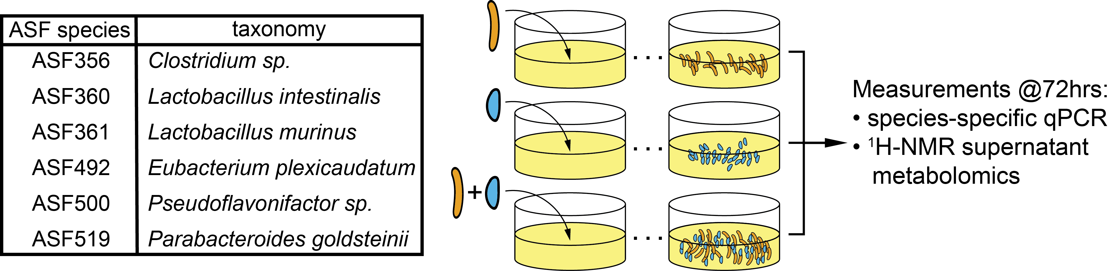
Characterizing metabolic interactions between members of a defined microbiota
Altered Schaedler flora (ASF): 8 bacterial species used to standardize the mouse microbiota
Start simple: pairwise interactions
Medlock et al. Cell Systems 2018
Background | Aim 1: metabolic interactions | Aim 2: metabolic capabilities | Conclusions
Notes:
For the first aim of inferring metabolic interactions between gut microbes, we selected members of a defined microbiota to perform experiments with. By defined microbiota, we mean bacterial species that make up a community used in isolated environments to control the microbiome composition of laboratory animals. For this, we selected the Altered shaedler flora, or ASf, a set of 8 bacterial species used to standardize the mouse microbiota.
For our study, we identified 6 of the species that we could culture in the same media condition, which we refer to by their 3 digit numerical code.

Slide 11
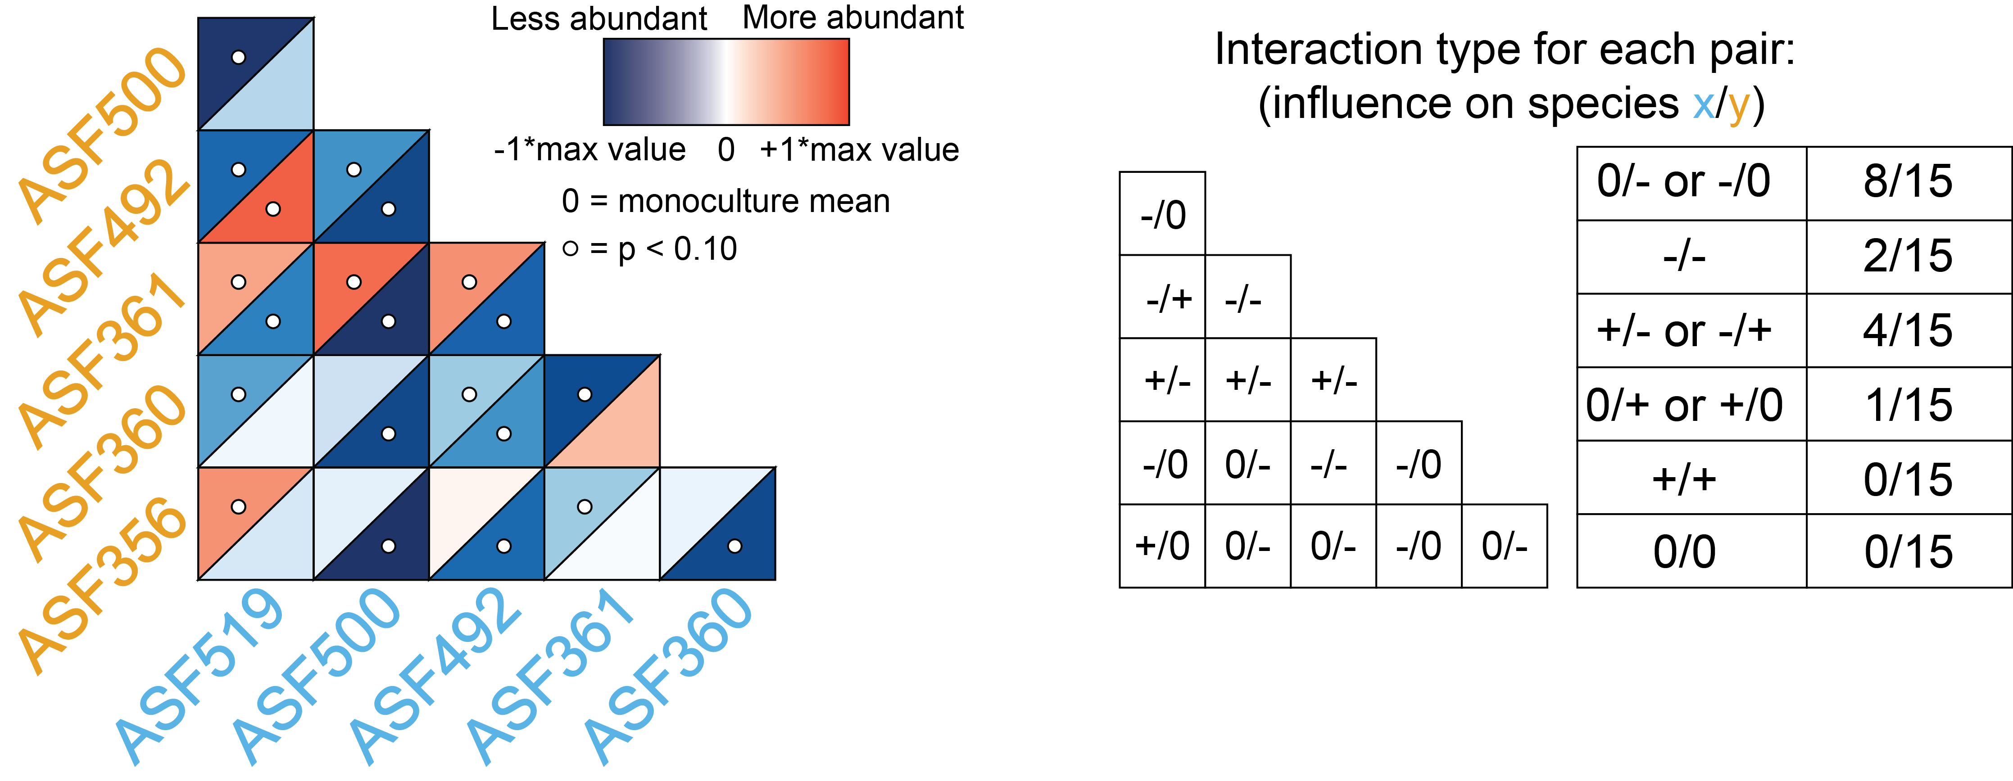
Growth interactions within the ASF
Most co-cultures had a negative effect on growth
Only one co-culture had a net-positive interaction
Medlock et al. Cell Systems 2018
Background | Aim 1: metabolic interactions | Aim 2: metabolic capabilities | Conclusions
Notes:
The population size outcomes are shown in this heatmap, where each cell indicates the abundance of each of the two species in each co-culture; the data are centered so that the monoculture abundance for each species is 0, so red indicates the species was more abundant in the co-culture and blue indicates the species was less abundant than in co-culture. So for example in this co-culture here, there was no impact on the abundance of ASF519, but ASF356 experienced a growth benefit.
Summarizing the results across all 15 co-cultures, we see that the majority of the interactions negatively influence growth relative to monoculture, while only one co-culture had a net positive interaction. So from a resource allocation standpoint, it looks like we may have quite a bit of competition in these co-cultures with limited cooperation. Given these changes in growth in co-culture, we next sought to understand the metabolic mechanisms that might underlie them.

Slide 12
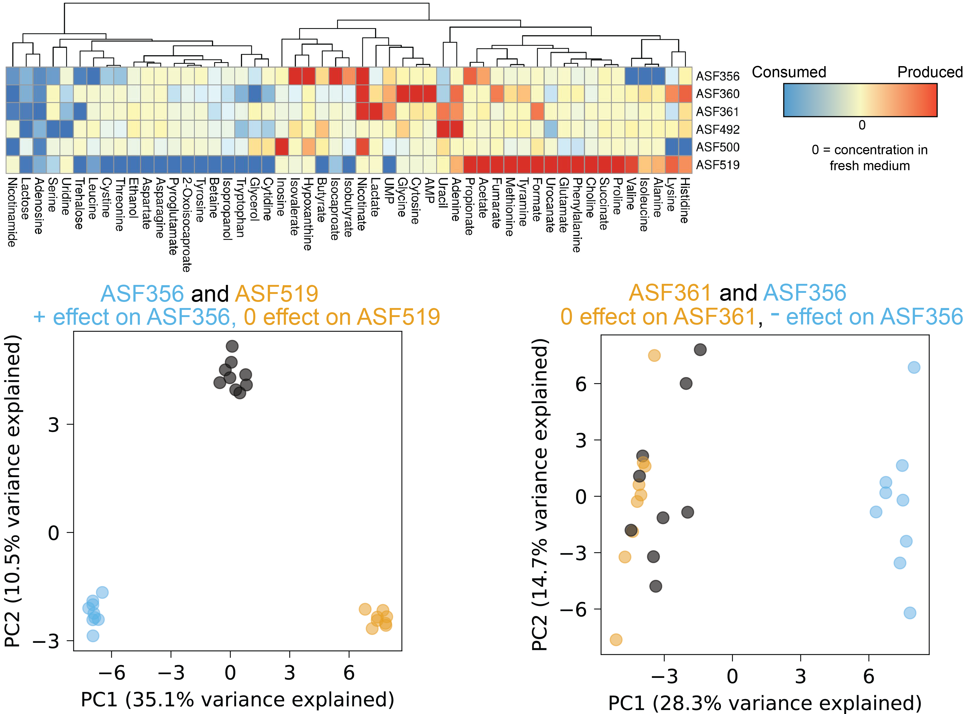
Metabolic profiling of mono- and co-culture supernatant
Co-culture
Co-cultures similar to
one monoculture
Which metabolites drive the growth interaction?
Co-culture vs.
monoculture
Monoculture separation
Medlock et al. Cell Systems 2018
Background | Aim 1: metabolic interactions | Aim 2: metabolic capabilities | Conclusions
Notes:
To do this, we performed hydrogen NMR spectroscopy-based metabolomics on supernatants from all samples in the study. The monoculture metabolomics data allowed us to identify metabolites consumed and produced by each species in the study. When we examine the co-culture metabolomics data alongside the monoculture data, a few striking trends emerge. First, we’ll look at this trend for ASF356 and ASF519, the only pairing that resulted in a net positive effect. When we perform principal component analysis on the metabolomics data from both the monocultures for these species and their co-culture, the first principal component, which describes the largest proportion of variance, separates the two monoculture groups, and the coculture samples lie directly in the middle of this first axis. This implies that the variance captured in the first axis discriminates between each of the monocultures, and the abundances of the metabolites represented in the loadings of the first principal component in coculture are simply a mixture of the two monocultures. In contrast, the second principal component separates the monocultures from the co-cultures, which means that there is variance in the dataset introduced by the co-cultures that can’t be explained by the mixing effect observed in principal component 1.
Given this, we could just look at the loadings of the PCA and say those in PC2 are driving the growth interaction, but we need to control for changes in the population size of each species in this analysis!

Slide 13
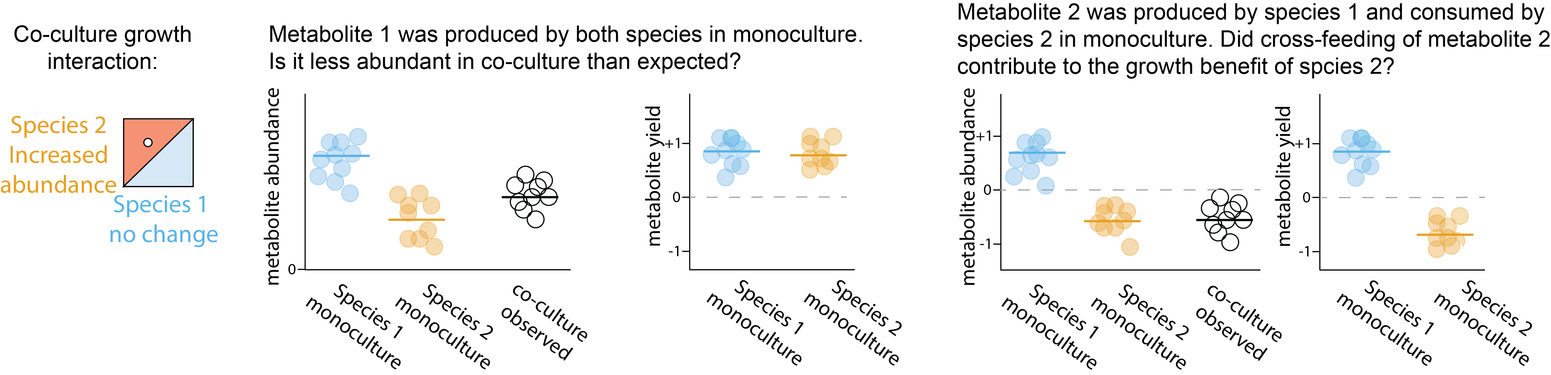
Species abundance changes confound interpretation of metabolomics data
Yield = Amount of metabolite produced/consumed
Amount of biomass produced
Given a yield-based expectation:
Did co-culture enhance or decrease yield
of this metabolite?
Did co-culture lead to cross-feeding?
Medlock et al. Cell Systems 2018
Background | Aim 1: metabolic interactions | Aim 2: metabolic capabilities | Conclusions
Notes:
To see this, imagine we have a scenario in which one strain experiences a growth benefit, and another strain has no appreciable change. Both of these strains produced a particular metabolite in monoculture, at the relative amounts shown here, and each had approximately equal yields for this metabolite based on the amount produced per unit of strain biomass. In trying to infer whether the co-culture behavior was as expected for this metabolite, we must ask whether the abundance observed in co-culture matches our expectation. To create this expectation, we decided to assume that behavior in co-culture should be differential if the apparent yield of a metabolite changed in co-culture relative to the monoculture behavior. That is, one of the strains produced a larger or smaller quantity of a metabolite per unit biomass in co-culture than it did in monoculture.
Pull out abundance plot, replace with heatmap version

Slide 14
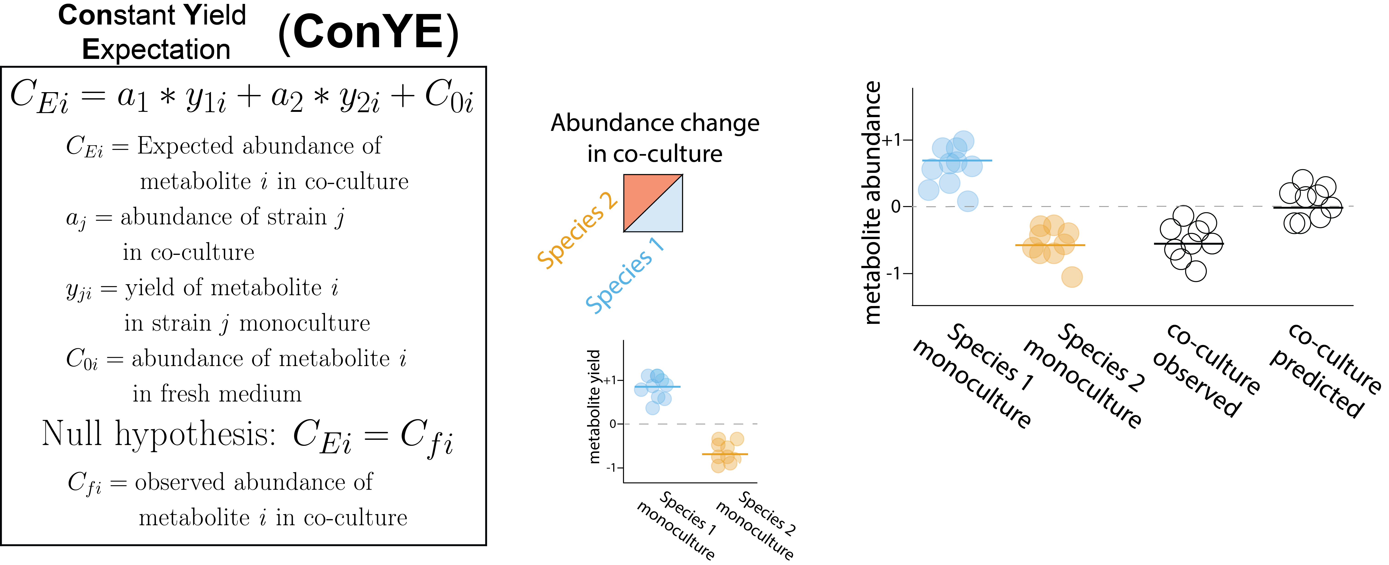
Accounting for species abundance and expected metabolite yield with ConYE
???
Medlock et al. Cell Systems 2018
Background | Aim 1: metabolic interactions | Aim 2: metabolic capabilities | Conclusions
Notes:
We tested this expectation formally by constructing what we have named the constant yield expectation model, or ConYE. In ConYE, we first generate an expected metabolite quantity for each co-culture, by summing the original quantity of the metabolite in the medium with change values derived from the abundance of each strain in co-culture multiplied by the yield of each metabolite for that strain in monoculture. So, given a yield for a metabolite that we calculate by determining the amount of metabolite produced per unit biomass for each species, we sum these quantities to produce our expectation value—that is, the quantity of the metabolite we expect to be present if each strain maintained their metabolic behavior from monoculture. One of these expected values is generated for every co-culture sample for every measured metabolite.
Then, we test the null hypothesis that this simulated quantities for a metabolite in a particular co-culture are equal to the actual observed quantity using standard univariate testing with multiple testing correction across all conditions. If we reject the null, this implies that differential behavior occurred for this co-culture and metabolite.
Shown to the right are examples of ConYE results for two metabolites across all co-culture conditions. In each plot, the lower left triangle in each cell is the observed abundance in co-culture, whereas the upper right is the expectation value calculated in ConYE. Here, red means the metabolite was produced, blue means consumed, and the asterisk indicates that the null hypothesis was rejected. So for lactose, which was consumed by all strains, we can interpret the result for 356 and 519 as lower consumption than expected, since the observed abundance of the metabolite is higher than the predicted abundance. This occurs for many of the co-cultures for lactose, suggesting either more efficient utilization of lactose in co-culture, or that other metabolites were utilized to contribute to biomass production.
An alternative case is that of Valine, which was produced by some species and consumed by others. Interestingly, we see that valine is generally as abundant as expected—implying that strains were able to maintain their consumption and production behavior in co-culture. We will revisit how this kind of result can aid our interpretation of potential mechanisms of interaction, as well as the caveats associated with it.

Slide 15
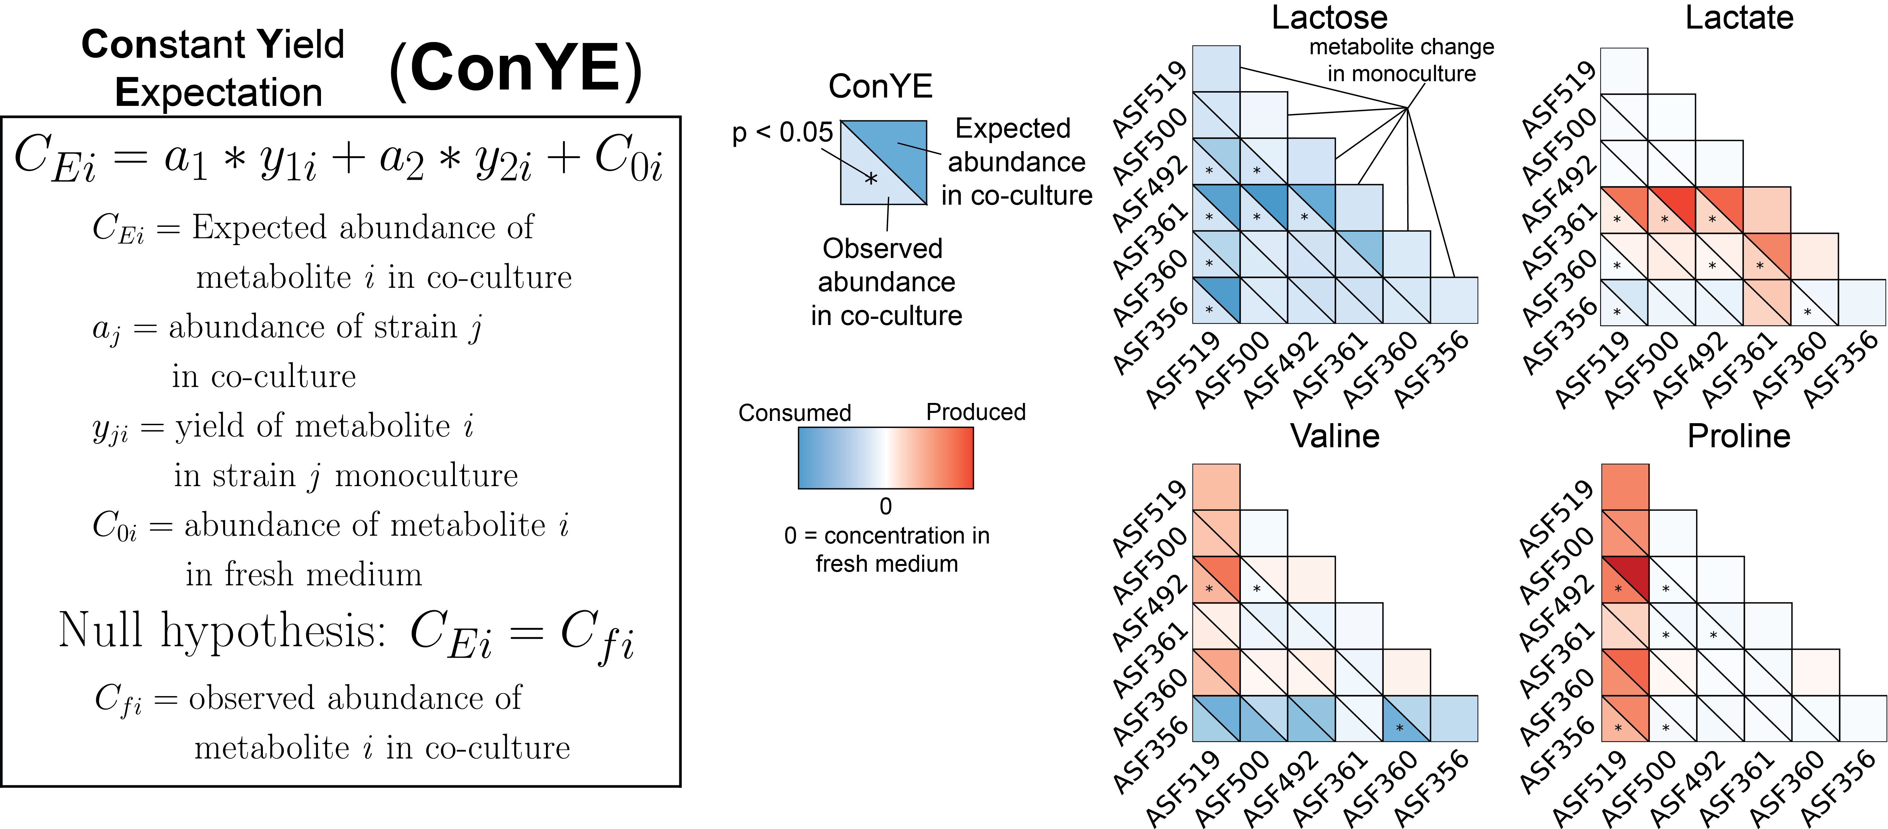
Accounting for species abundance and expected metabolite yield with ConYE
Less consumption than expected suggests increased biomass yield or use of alternative energy sources
Medlock et al. Cell Systems 2018
Background | Aim 1: metabolic interactions | Aim 2: metabolic capabilities | Conclusions
Notes:
We tested this expectation formally by constructing what we have named the constant yield expectation model, or ConYE. In ConYE, we first generate an expected metabolite quantity for each co-culture, by summing the original quantity of the metabolite in the medium with change values derived from the abundance of each strain in co-culture multiplied by the yield of each metabolite for that strain in monoculture. So, given a yield for a metabolite that we calculate by determining the amount of metabolite produced per unit biomass for each species, we sum these quantities to produce our expectation value—that is, the quantity of the metabolite we expect to be present if each strain maintained their metabolic behavior from monoculture. One of these expected values is generated for every co-culture sample for every measured metabolite.
Then, we test the null hypothesis that this simulated quantities for a metabolite in a particular co-culture are equal to the actual observed quantity using standard univariate testing with multiple testing correction across all conditions. If we reject the null, this implies that differential behavior occurred for this co-culture and metabolite.
Shown to the right are examples of ConYE results for two metabolites across all co-culture conditions. In each plot, the lower left triangle in each cell is the observed abundance in co-culture, whereas the upper right is the expectation value calculated in ConYE. Here, red means the metabolite was produced, blue means consumed, and the asterisk indicates that the null hypothesis was rejected. So for lactose, which was consumed by all strains, we can interpret the result for 356 and 519 as lower consumption than expected, since the observed abundance of the metabolite is higher than the predicted abundance. This occurs for many of the co-cultures for lactose, suggesting either more efficient utilization of lactose in co-culture, or that other metabolites were utilized to contribute to biomass production.
An alternative case is that of Valine, which was produced by some species and consumed by others. Interestingly, we see that valine is generally as abundant as expected—implying that strains were able to maintain their consumption and production behavior in co-culture. We will revisit how this kind of result can aid our interpretation of potential mechanisms of interaction, as well as the caveats associated with it.

Slide 16
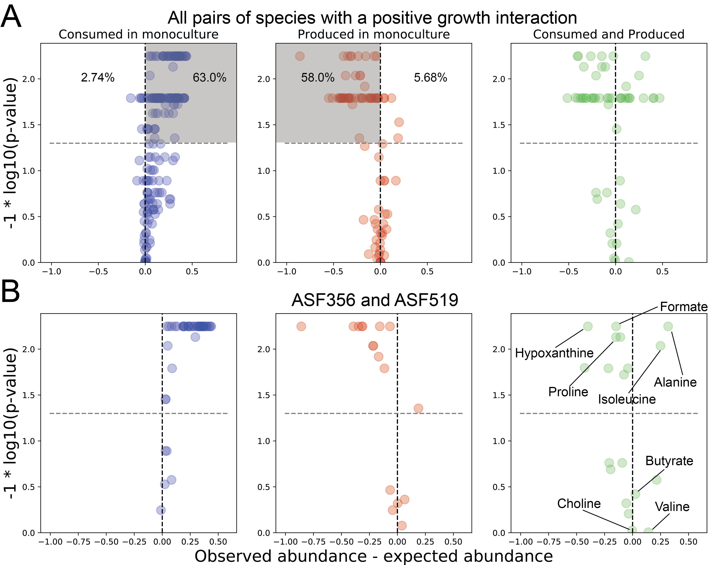
Resource utilization in co-cultures with positive growth interactions
Decreasing
p-value
Less abundant
than expected
More abundant
than expected
Less abundant
than expected
More abundant
than expected
Species generate biomass more efficiently in co-culture
Medlock et al. Cell Systems 2018
Background | Aim 1: metabolic interactions | Aim 2: metabolic capabilities | Conclusions
Notes:
In trying to understand how co-culture growth behavior might be explained by our metabolomics data, we examined the ConYE results for all metabolites for all co-cultures in which at least one species experienced a growth benefit. We found that these positively interacting species appeared to use their resources more efficiently in co-culture than in monoculture. We can present this data on a volcano plot, where the x axis describes the magnitude of the difference between the observed and expected values, so metabolites to the right were more abundant in co-culture and metabolites to the left were less abundant than expected in co-culture. The y axis describes the p-value for the comparison, so as we go up on this axis, the p value decreases, and any point above this dashed grey line has a p value lower than our significance threshold. For metabolites that either of the species in a co-culture consumed when grown in monoculture, 63% were more abundant than expected based on ConYE, implying that more biomass was produced per unit consumed of each of these metabolites. This is in sharp contrast to the opposite scenario, where only 2.7 percent of consumed metabolites were less abundant than expected.
In support of our interpretation of increased efficiency in co-culture, metabolites that were produced in monoculture tended to be less abundant than expected, implying that a smaller amount of product secretion was required per unit biomass in co-culture.
There are many reasons that these trends could emerge, but their existence suggest that there is substantial metabolic interaction amongst these species.
Cases where metabolites that were consumed by one species in monoculture and produced by another species in monoculture are more difficult to interpret.

Slide 17
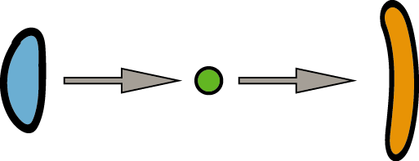
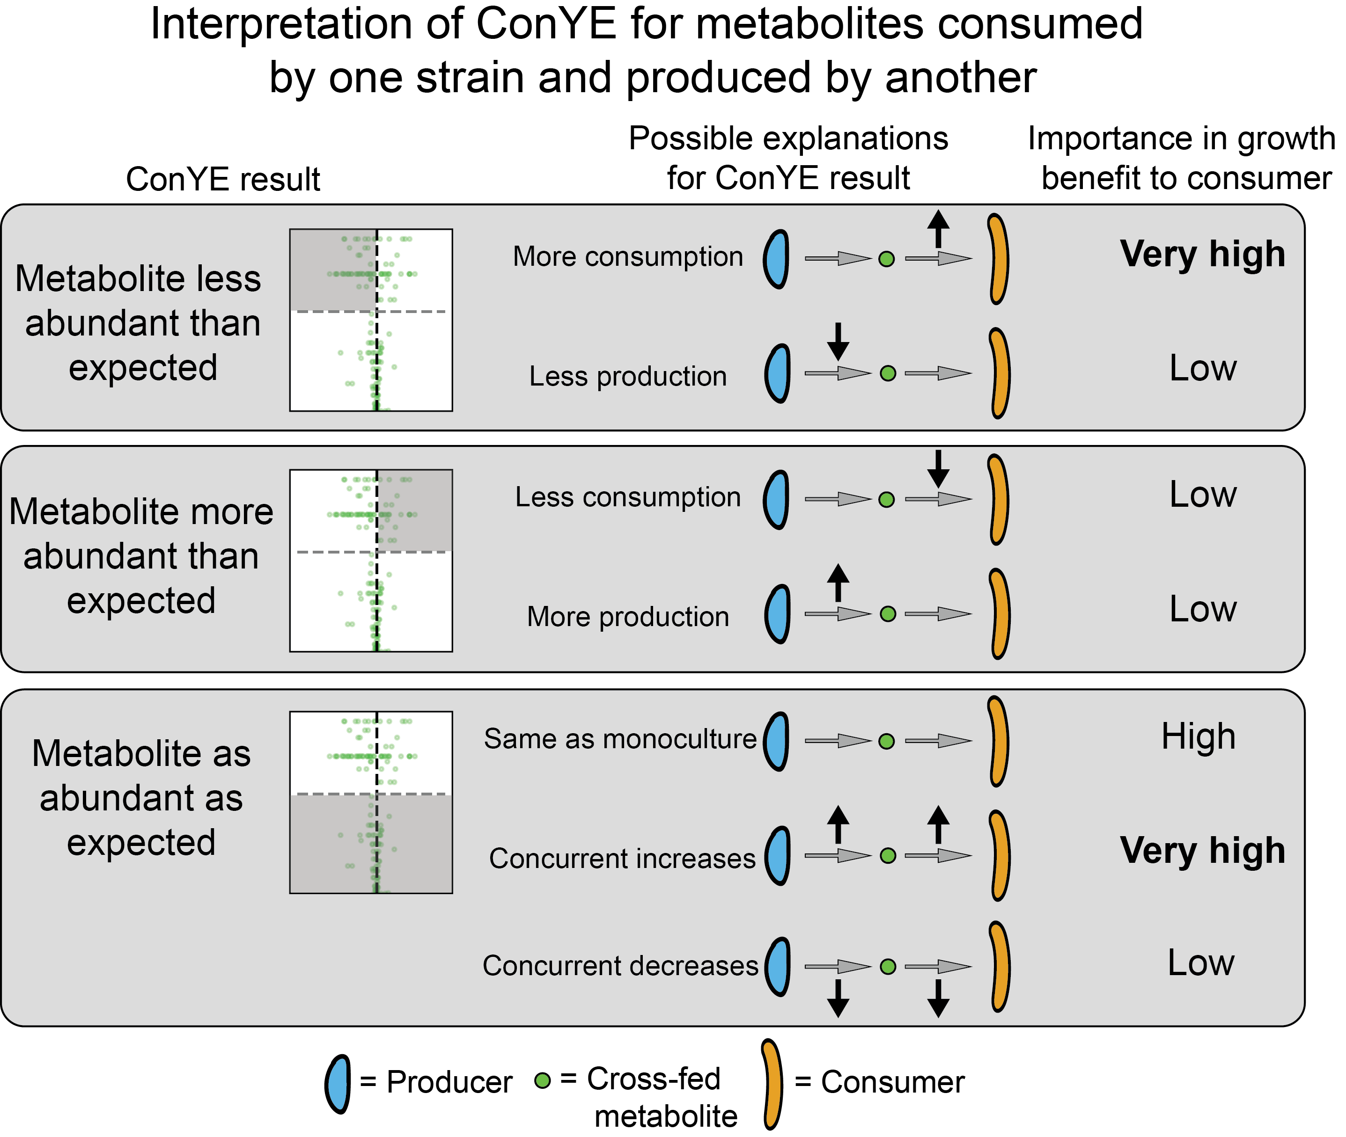
Evidence for cross-feeding from ConYE
Decreasing
p-value
Less abundant
than expected
More abundant
than expected
Medlock et al. Cell Systems 2018
Background | Aim 1: metabolic interactions | Aim 2: metabolic capabilities | Conclusions

Slide 18
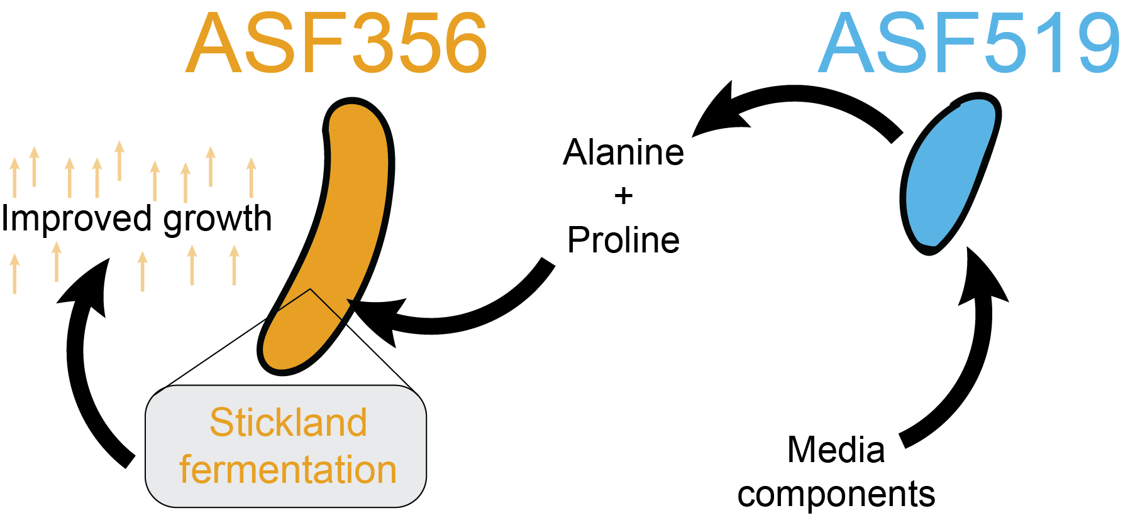
Experimental support for an inferred cross-feeding interaction
ConYE inferences + computational metabolic models + literature searches
Hypothesis: ASF356 and ASF519 cross-fed pairs of amino acids and co-metabolized them.
Verified w/ monoculture experiments: supplementation with putatively cross-fed amino acids leads to a growth benefit for ASF356, recapitulating the co-culture behavior.
Medlock et al. Cell Systems 2018
Background | Aim 1: metabolic interactions | Aim 2: metabolic capabilities | Conclusions
Notes:
Based on our ConYE inferences and rulesets, and further motivated by ensemble-based model simulations and a literature search, we developed a hypothesis that within our positively interacting pair, one species produced amino acids that were co-metabolized by the second species.
We verified this activity with monoculture supplementation experiments with the putatively cross-fed amino acid pairs

Slide 19
Aim 1 Conclusions
Profiled growth interactions within a defined murine microbiota.
Developed ConYE to account for changes in growth to identify specific metabolites that might govern growth interactions.
Used ConYE to identify a cross-feeding interaction powered by a previously unidentified metabolic capability in ASF356.
Medlock et al. Cell Systems 2018
Background | Aim 1: metabolic interactions | Aim 2: metabolic capabilities | Conclusions
Notes:
Together, these points emphasize how the framework presented in Aim 1 advance our understanding of community function of the ASF through new data and insights, specifically guiding targeted hypothesis testing to discover a new biochemical function underlying a growth interaction.
A high throughput screening tool to generate mechanistic hypotheses that can be followed up on using more targeted experiments.

Slide 20
Knowledge gaps preventing treatment of microbiome-associated diseases:
Figuring out mechanisms of association is difficult.
Aim 1: inferring metabolic mechanisms of interaction between gut microbes
We don’t understand gut microbe behavior enough to manipulate them.
Aim 2: Prioritizing characterization of gut microbe metabolism through computational modeling
Background | Aim 1: metabolic interactions | Aim 2: metabolic capabilities | Conclusions
Notes:
Having addressed some of the gaps in identifying mechanisms responsible for interactions between gut microbes, we now turn to functions of the individual species and how we can prioritize our functional characterization of them in the future.

Slide 21
The problem: lack of functional characterization for gut microbes
>10 million unique genes
Only ~20-40% with known function
... What would we do if we knew the functions?
Background | Aim 1: metabolic interactions | Aim 2: metabolic capabilities | Conclusions
Notes:
First, I’ll remind you of the scope of the problem. There are millions of genes of unique functions within the human microbiome, and only a small percentage of them have known functions.
But, what is the goal of characterization? What can you do if you know the functions of these genes?

Slide 22
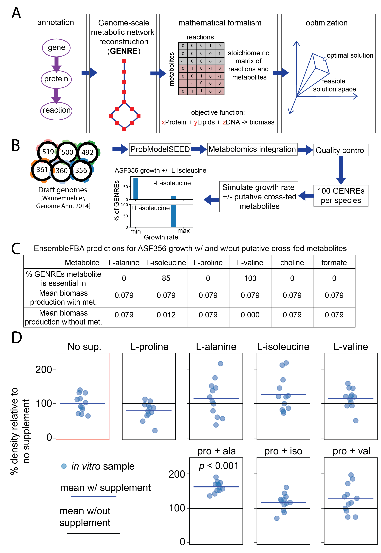
Systems biology: a framework for representing and modeling biology
Enables:
drug target identification
growth simulation across varying environments
Quality of models depends entirely on quality of annotation
Background | Aim 1: metabolic interactions | Aim 2: metabolic capabilities | Conclusions
Notes:
System biology is one framework for making use of this knowledge. In general, systems biology refers to the organization of biological knowledge to improve our ability to contextualize data describing an organism in the context of all of their physiology.
Genome-scale metabolic network reconstructions, or GENREs, are an example of systems biology in practice, which we’ll use throughout this aim. A GENRE is generated by annotating all of the genes in an organisms genome or that are known to occur experimentally, then assembling those annotation into a network structure, linking all of the reactions together. These networks can be formalized mathematically as a stoichiometric matrix, which describes the conversions of metabolites in every reaction in the network. Next, more complex biological functions are introduced to simulate behavior of interest, such as microbial growth. Growth is represented mathematically as production of biomass from the constituent metabolites that make it up—proteins, lipids, nucleotides, and the such. With this model in hand, we can apply numerical optimization, to identify network-wide states that enable optimal production of biomass or other phenotypes.
This modeling approach has been used widely for drug target identification or simulation of growth in varying environments, thus it has great promise for the study of metabolism of gut microbes.
However, the quality of these models depends entirely on the quality of annotation. This annotation is extremely lacking for gut microbes, as we’ve discussed in the context of the entire microbiome.

Slide 23
Why would we use these models for poorly-characterized gut microbes?
A model represents a hypothesis about how an organism functions
Treating models as hypotheses can accelerate research by helping identify informative experiments
Background | Aim 1: metabolic interactions | Aim 2: metabolic capabilities | Conclusions
Notes:
So why would we use these models for poorly-characterized gut microbes?
The key is that a computational model represents a hypothesis about how an organism functions.
When we treat models as hypotheses, it can accelerate research by helping us identify the most informative experiments.

Slide 24

Constructing hypotheses improves decision-making
Hypothesis 1: Blue driver is late for work
Hypothesis 2: Blue driver is suffering from road rage
Experiment to resolve our uncertainty: Pull over and see if they pass
If pass: Hypothesis 1
No Pass: Hypothesis 2, do not engage!
https://www.motoringresearch.com/car-news/tailgating-kills-seriously-injures-100-people-year/
Background | Aim 1: metabolic interactions | Aim 2: metabolic capabilities | Conclusions
Notes:
Let’s demonstrate this witha n example. Say you’re driving this green car, and this blue car is tailgating you.
One potential hypothesis that explains this behavior is that the blue driver is late for work. You are a bystander.
Another hypothesis is that the blue driver is suffering from road rage.
You can perform an experiment based on these hypotheses to gain more information and reduce your uncertainty—pull over and see if they pass.
If they pass, hypothesis 1 is likely correct.
If they don’t pass and they start following you, hypothesis 2 is probably correct. Don’t get out of your car.
This example demonstrates how formulating hypotheses can help us make decisions, but it also demonstrates and important concept we’ll use moving forward—considering multiple hypotheses generally improves decision-making.

Slide 25
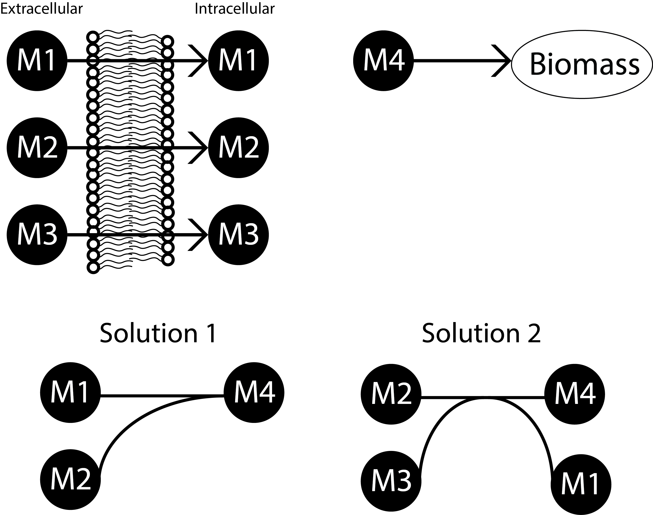
Multiple explanations for the structure of a metabolic network
Hypothesis 1
Hypothesis 2
GENREs for gut microbes have many gaps, and generally 1000s of alternative ways to fill those gaps
Background | Aim 1: metabolic interactions | Aim 2: metabolic capabilities | Conclusions
Notes:
So, how does this logic come about when using metabolic networks?
Imagine we have this toy network, in which three metabolites are imported, and a 4th metabolite is used to produce biomass. In it's current state, the network is incapable of carrying flux through to produce M4, yet we know that the organism is able to grow in this media condition. One way to fill this gap might be by adding this particular reaction in solution 1, which converts m1 and M2 to M4. Alternatively, we could add this other reaction, in solution 2, which converts M2 and M3 to M4 and M1. In the absence of additional evidence, we have no way of determining whether solution 1 or solution 2 is more likely.
Phrased another way, adding the first reaction to our network gives us hypothesis 1, whereas adding the other network gives us hypothesis 2.
Now, keep in mind that GENREs or networks for gut microbes have many gaps due to how little we know about them—this generally results in thousnads of alternative ways to fill those gaps.

Slide 26
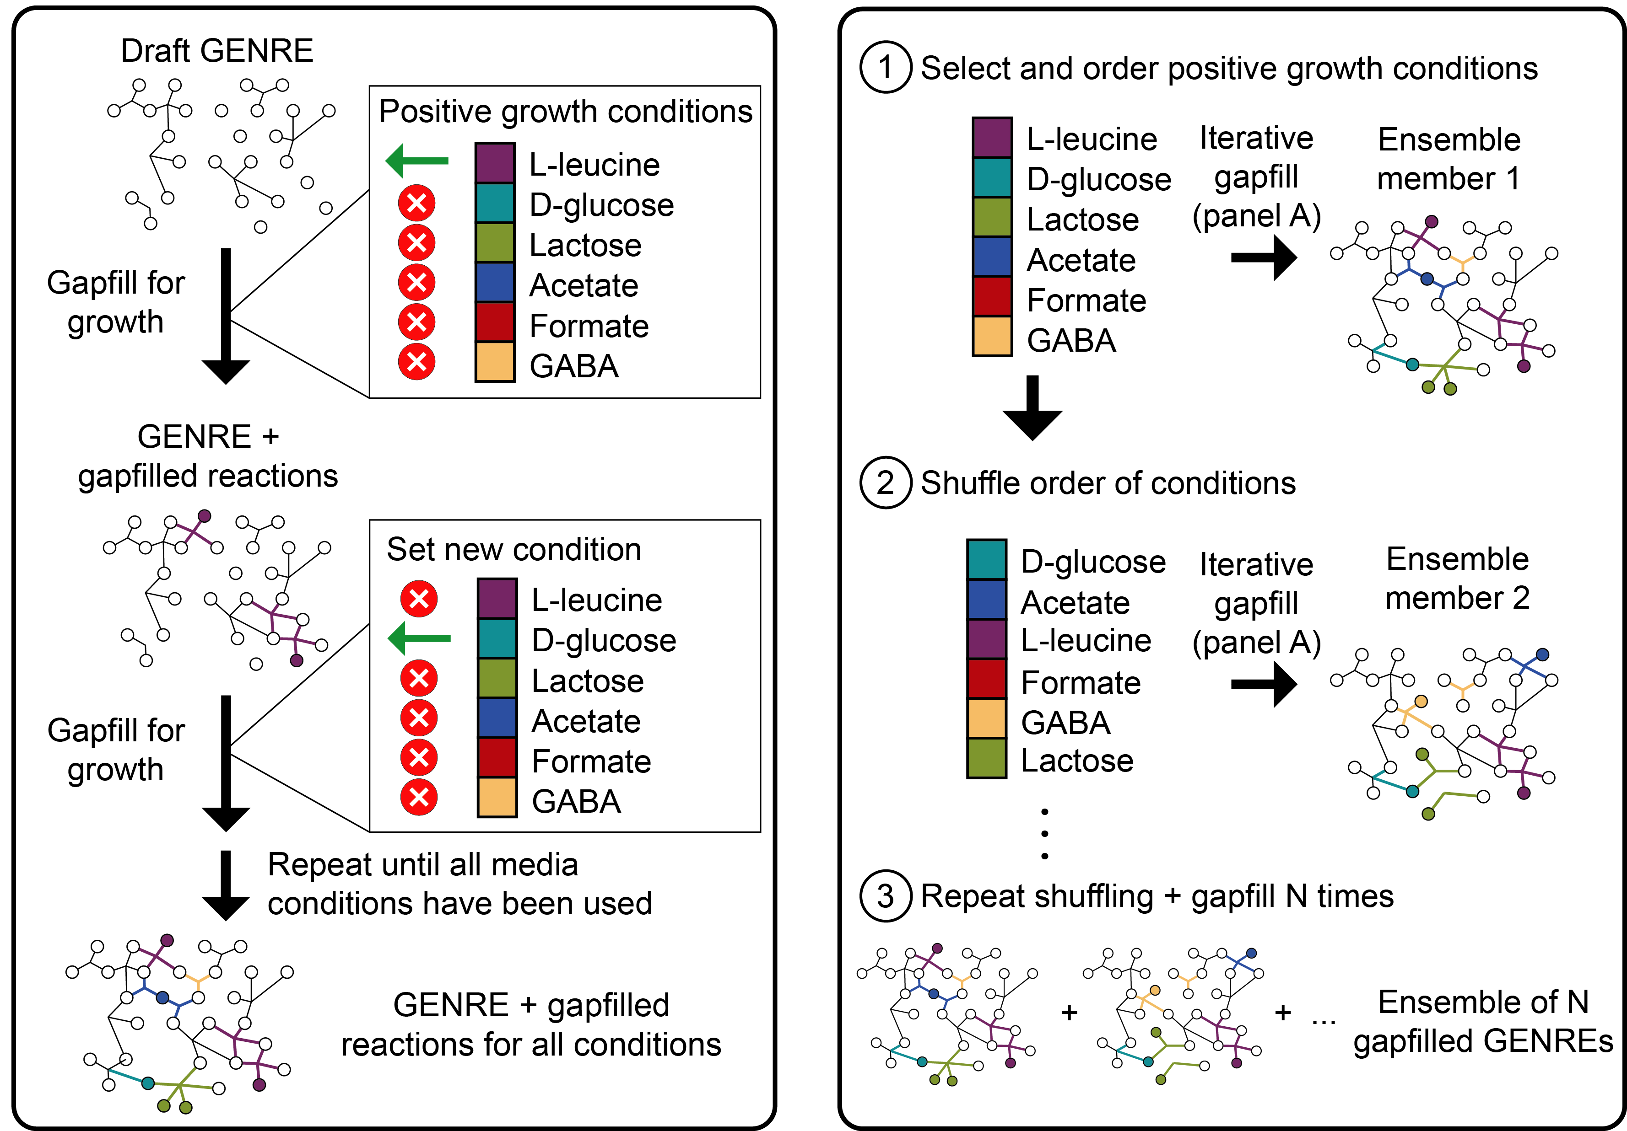
Multiple explanations in metabolic modeling: Ensemble modeling
Background | Aim 1: metabolic interactions | Aim 2: metabolic capabilities | Conclusions
Notes:
Let’s dig deeper into how we construct multiple hypotheses for GENREs.
We can start with a draft GENRE composed of reactions an organism that is poorly understood catalyzes. If we have experimental data for conditions that the organism grow in, we can model this scenario computationally and identify the gaps int eh network that must be filled to enable growth.
After doing this for one media condition, we can cycle to the next, iteratively adding reactions to enable growth on each condition until we’ve exhausted all conditions. At the end, we have a network with additional gapfilled reactions that can simulate growth on each of these media conditions.
Now, if we perform this process, what we get is a single model. Here, we’re going to repeat the process to generate an ensemble of models, so we’ll consider this first network ensemble member 1. Next, we shuffle the order of the media conditions, start with a fresh draft network, then repeat the gapfilling performed on the left. Because of the shuffling of conditions, the solution we get back is slightly different, and we’ve genreated a second, unique enesemble member.
To generate a large ensemble, we keep repeating this process. At the end, we have an ensemble composed of metabolic networks for the same organisms that are all equally likely based on our evidence.

Slide 27
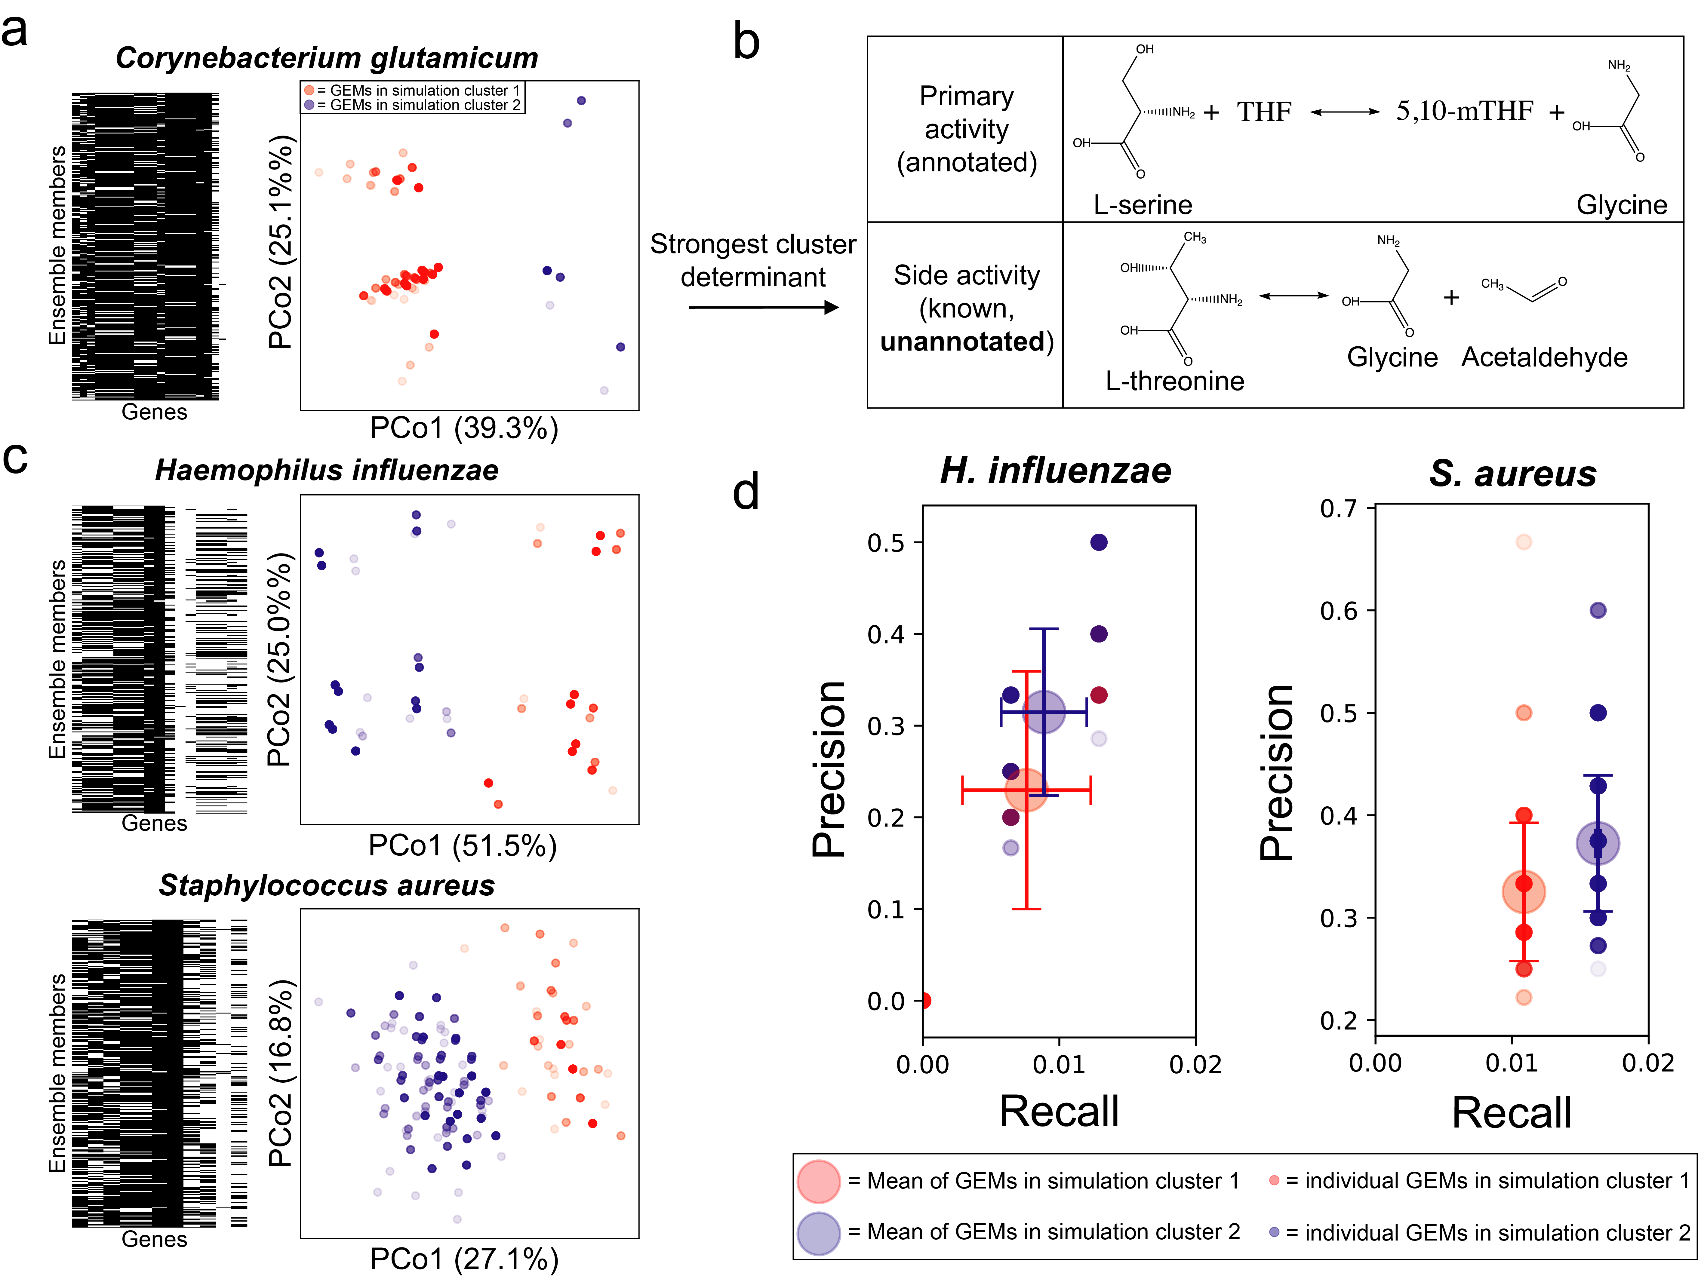
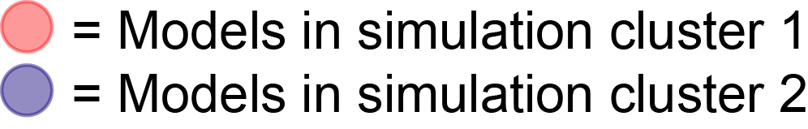
Variation in essential genes across an ensemble
Apply unsupervised machine learning (k-means clustering)
Models within each cluster have similar gene essentiality predictions
Medlock & Papin, bioRxiv 2018
Background | Aim 1: metabolic interactions | Aim 2: metabolic capabilities | Conclusions
Notes:
Once we have an ensemble of models, we can start to make interesting predictions with them and see how those predictions differ. Gene essentiality predictions can be made with these network by inactivating a gene and trying to simulate growth—if the organism can no longer grow, then the gene is essential. With an ensemble of models, each model generates a particular profile of essential or nonessential predictions for each gene.
We can summarize the variation across all model predictions with unsupervised machien learning. Here, we use k-means clustering to generate 2 clusters of models. Essentially, this results in models in each cluster that have similar essentiality prediction profiles.

Slide 28
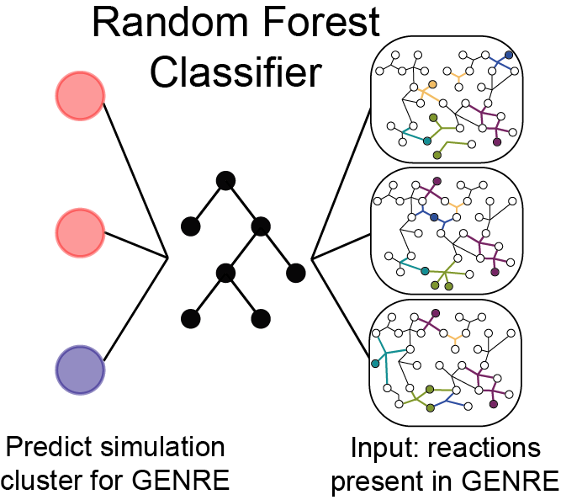
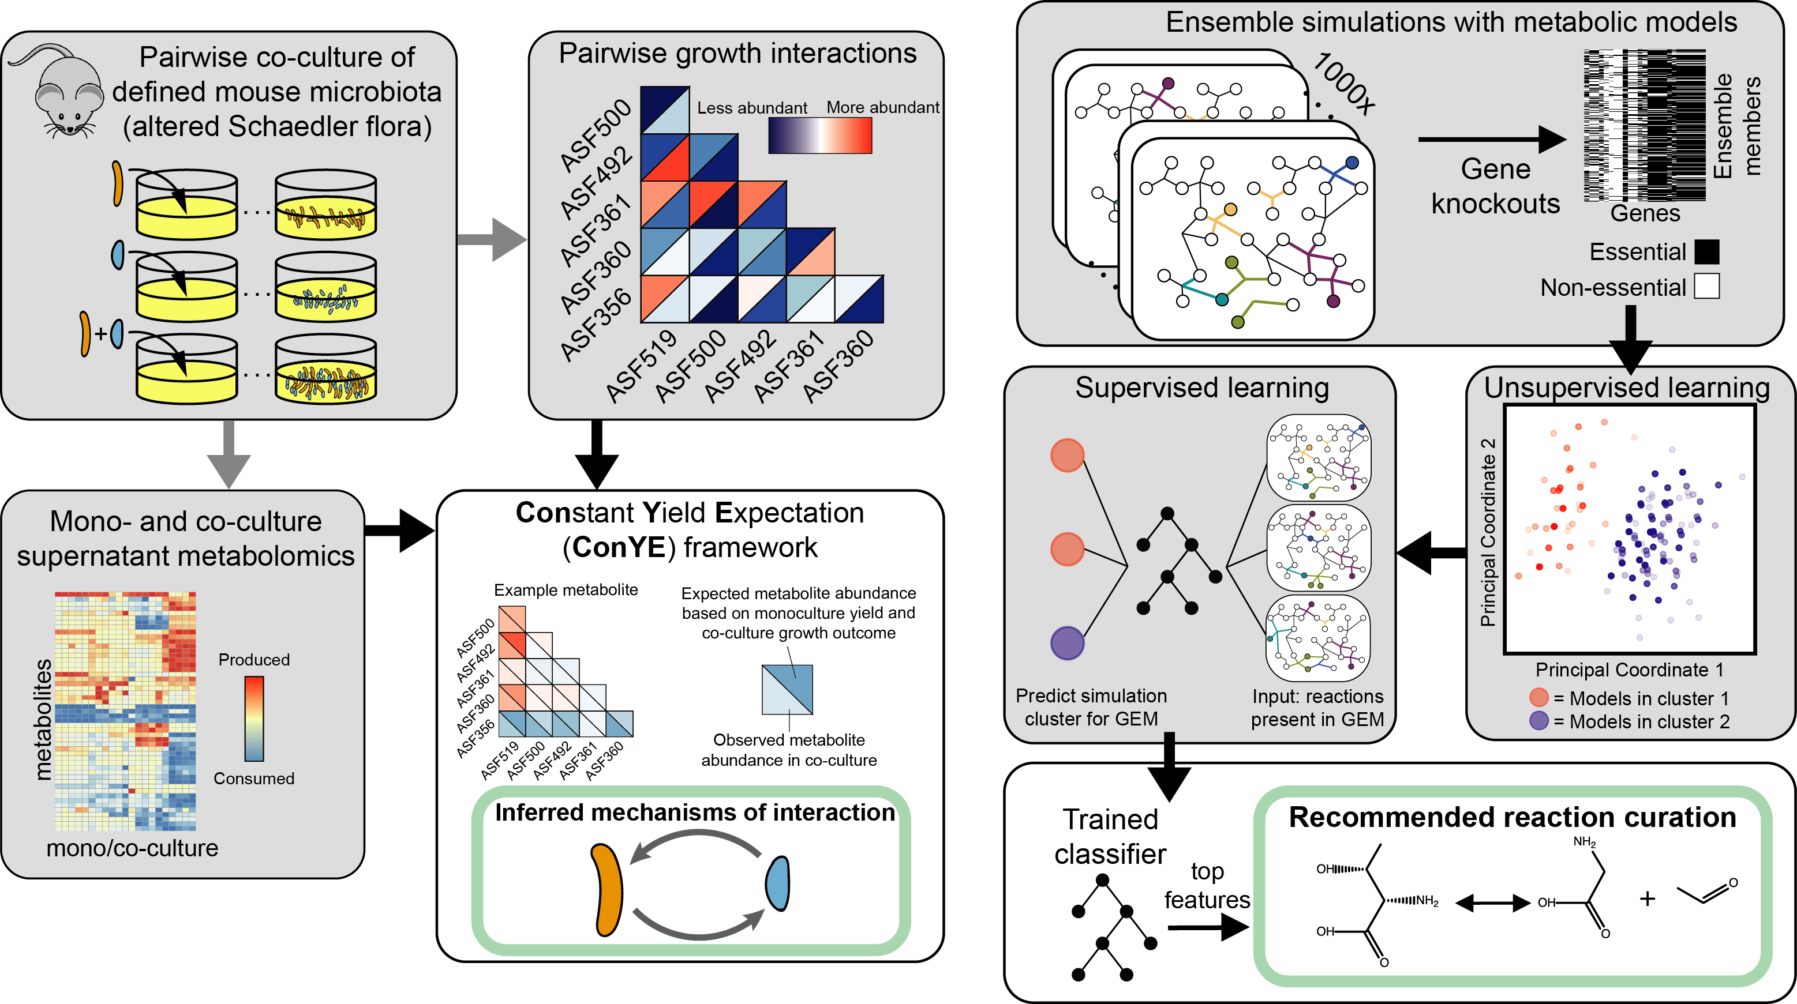
Combining ensembles and machine learning to guide model curation
Medlock & Papin, bioRxiv 2018
Background | Aim 1: metabolic interactions | Aim 2: metabolic capabilities | Conclusions
Notes:
With these cluster assignments in hand, we can turn back to the networks them selves to associate the alternative hypotheses we constructed with specific predictions made based on those hypotheses.
To do this, we take the cluster assignments and treat them as labels in a supervised machine learning classification problem. Here, we use the random forest algorithm to predict the cluster label for each ensemble member using the network structure for that model. In other words, we identify associations between specific parts of each hypothetical network and the predictions those network make.
After training the randoom forest classifer, we can inspect it’s structure to identify the network features that are most predictive of whether a network belonged to simulation cluster 1 or 2. If we resolve the true state of that feature, so whether or not the reaction actually occurs in this organism, we can start to resolve whether the models in the blue cluster or the red cluster are closer to reality.

Slide 29
~90% of models
~10% of models
Medlock & Papin, bioRxiv 2018
Background | Aim 1: metabolic interactions | Aim 2: metabolic capabilities | Conclusions
Notes:
Here we’ll go over an example of how this method can be used to guide the curation of these networks. We performed this process for C glutamicum, a bacterium used for the industrial production of amino acids.
After constructing an ensemble, performing k-means clustering, and training a random forest classifier, we identified the most discriminatory reactions that should be curated for this organism. In the red cluster, which represents 90% of the models for this species, the models contained a reaction that converted serine to glycine with the help of tetrahydrofolate.
In the blue cluster, representing 10% of all the models for this species, the models had an alternative function for this same enzyme, using threonine instead of serine as a precursor.
After getting this recommendation by our curation system, we turned to the literature and found that this activity in the blue cluster does indeed occur in C glutamicum, and has actually very recently been essential for improving genetic manipulation to enhance production of glycine industrially.
One critical aspect this example shows is that the majority does not always rule—if we had assumed that because 90% of the models did not have this function, it isn’t their, we would have missed it entirely. That is one of the primary advantages of a machine-learning guided recommendation system.

Slide 30
Medlock & Papin, bioRxiv 2018
Background | Aim 1: metabolic interactions | Aim 2: metabolic capabilities | Conclusions
Notes:
To demonstrate the utility and scalability of this method, we applied it to 29 bacterial species for which adequate genomic and experimental data were available for. As a result of this, we’ve identified high-priority areas of curation to improve the predictions that we made using the models.

Slide 31
Putting it all together: a guidance system for functional characterization
Efficiency is critical: 10,000s of species of gut microbes
This is the first automated system for guiding curation
Future: need more data to apply to gut microbes
Medlock & Papin, bioRxiv 2018
Background | Aim 1: metabolic interactions | Aim 2: metabolic capabilities | Conclusions
Notes:
To summarize, This aim resulted in an automated guidance system for functional characterization of microbes. We used ensemble modeling of genome-scale metbaolic network reconstructions, coupled with ensemble simulations, unsupervised machine learning, and supervised machine learning to pinpoint differences in hypohtetical networks that drive uncertainty in the predictions made with them.
The efficiency of this process, and the focus on maximum-value characterization is critical for gut microbes—it will likely never be feasible to characterize all functions in all 10,000 species of gut microbes, so we have to prioritize our work.
To our knowledge, this is the first such system for guiding curation of genome-scale metabolic network reconstructions, and we are excited to apply it more in the future.
That said, significantly more experimental data are needed for gut microbes in order to make this approach feasible.

Slide 32
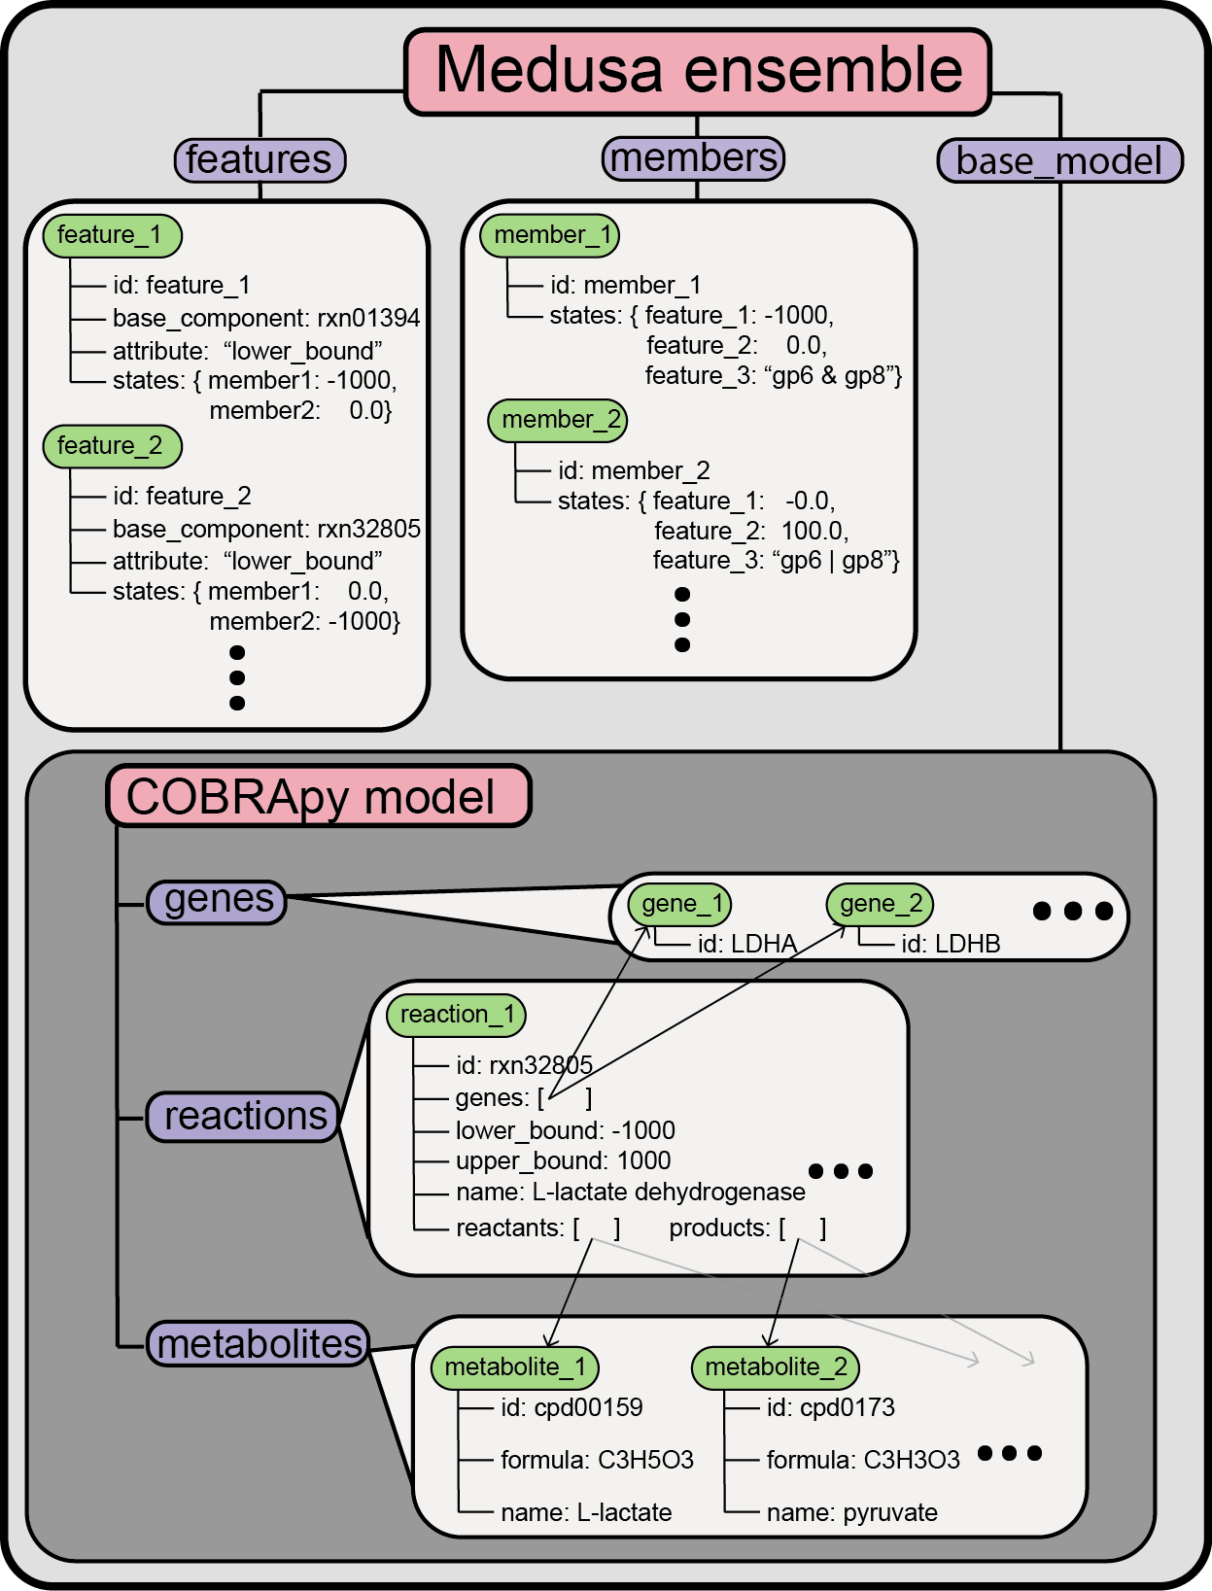
Making ensemble analysis possible
Created Medusa
Open-source python package that builds on community efforts from COBRApy
Medlock & Papin, in preparation
Background | Aim 1: metabolic interactions | Aim 2: metabolic capabilities | Conclusions
Notes:
During the work in aim 2, we created a software package, called Medusa, to implement most of the analyses we performed and to serve as a framework for ensemble modeling methods in the future. Medusa is an open source project that builds on cobrapy, a popular community-driven python package for analysis of genome-scale metabolic network reconstructions.

Slide 33
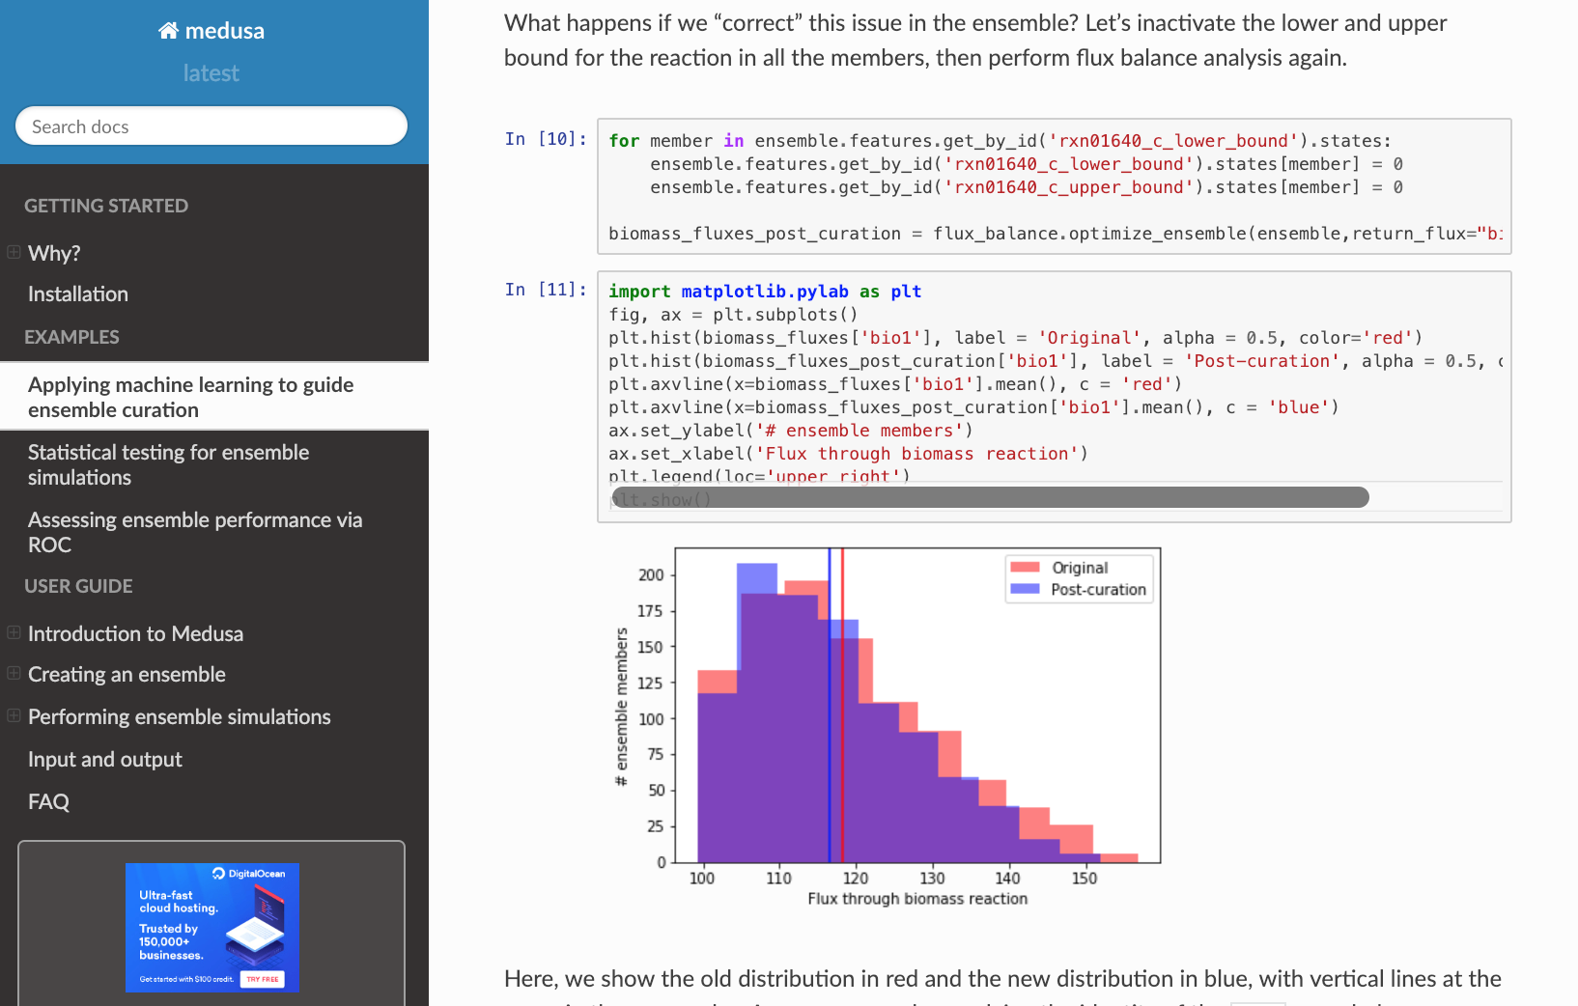
Medusa documentation
Background | Aim 1: metabolic interactions | Aim 2: metabolic capabilities | Conclusions
Notes:
In addition to making these analyses possible for others through software infrastructure, we’re also trying to make it more probable by developing documentation. Documentation is available online for Medusa, including a breakdown of functionality as well as narrated examples of analyses that medusa makes possible.

Slide 34
Aim 2 Conclusions
Aim 2:
Prioritize functional characterization of microbes
Developed a method to prioritize characterization of microbes using machine learning and ensemble modeling
Demonstrated by applying to 29 bacterial species
Developed infrastructure for this approach and broader development and application of ensemble modeling through Medusa
Background | Aim 1: metabolic interactions | Aim 2: metabolic capabilities | Conclusions
Notes:
In sum, in Aim 2 we have developed a method to prioritize the characterization of microbes using machine learning and ensemble modeling.
We demonstrated the utility of this method, as well as it’s scalability, by applying it to 29 bacterial species to identify curation targets.
Lastly, we developed infrastructure for this approach and broader development and applicaiton of ensemble methods through Medusa, our new software package.

Slide 35
Conclusions
Figuring out mechanisms of association is difficult.
Aim 1: inferring metabolic mechanisms of interaction between gut microbes
we don’t understand gut microbe behavior enough to manipulate them.
Aim 2: Prioritizing characterization of gut microbe metabolism through computational modeling
Background | Aim 1: metabolic interactions | Aim 2: metabolic capabilities | Conclusions
Notes:
Together, aims 1 and 2 of this dissertation have helped address these key gaps preventing development of microbiome therapies, by advancing our ability to understand interactions between microbes, and providing a framework for the future characterization of metabolic functions in gut microbes.

Slide 36
Publications resulting from this work
Aim 1:
Medlock GL, Carey MA, McDuffie DG, Mundy MB, Giallourou N, Swann JR, Kolling GL, Papin JA. “Inferring Metabolic Mechanisms of Interaction Within a Defined Gut Microbiota”. Cell Systems 2018;7:245-257.
Cell Systems most-read article, Aug-Oct 2018
UVA Health System press release
Nature Methods Research Highlight (November 2018)
Highlighted in Nature Methods “Methods to Watch” on Microbial Interactions (December 2018)
Aim 2:
Medlock GL, Papin JA. “Guiding the refinement of biochemical knowledgebases with ensembles of metabolic networks and semi-supervised learning”. bioRxiv, 2018. Under review.
Medlock GL, Papin JA. Building and analyzing ensembles of genome-scale metabolic network reconstructions using Medusa. In prep.
Notes:
The work that I presented in this dissertation is all either published or in prep for publication. Aim 1 is represented in a paper in cell systems that we published in August of 2018. It’s gotten a lot of nice readership and feedbakc that has made it’s way back to us—it was the most read article in cell systems from the day it came out through the end of october, and we prepped a nice press release covering the paper with the UVA Health System. Additionally, it was highlighted in Nature methods in a research highlight in November as well as a “methods to watch” commentary in December.
The curation guidance work in aim 2 is currently preprinted and under review, and we are preparing a manuscript describing our ensemble modeling software to be submitted soon.

Slide 37
Collaborative publications
Lieven C, Beber ME, Olivier BG, Bergmann FT, COBRA consortium. Memote: A community-driven effort towards a standardized genome-scale metabolic model test suite. bioRxiv, 2018.
Medlock GL*, Giallourou N*, Bolick DT, Medeiros PHQS, Ledwaba SE, Kolling GL, Tung K, Guerry P, Swann JR, Guerrant RL. A novel mouse model of Campylobacter jejuni enteropathy and diarrhea. PLoS Pathogens. 2018.
Carey MA, Covelli V, A Brown, Medlock GL, Haaren M, Cooper JG, Papin JA, Guler JL. Influential parameters for the analysis of intracellular parasite metabolomics. mSphere 2018.
Moutinho TJ, Panigides JC, Biggs MB, Medlock GL, Kolling GL, Papin JA. Novel co-culture plate enables growth dynamic-based assessment of contact-independent microbial interactions. PLoS ONE. 2017.
Bolick DT, Mayneris-Perxachs J, Medlock GL, Kolling GL, Papin JA, Swann J, Guerrant RL. Increased Urinary Trimethylamine N-Oxide Following Cryptosporidium Infection and Protein Malnutrition Independent of Microbiome Effects. J Infect Dis. 2017,
Bartelt LA, Bolick DT, Mayneris-Perxachs J, Kolling GL, Medlock GL, Zaenker EI, Donowitz J, Thomas-Beckett RV, Rogala A, Carroll IM, Singer SM, Papin JA, Swann JR, Guerrant RL. Cross-modulation of pathogen-specific pathways enhances malnutrition during enteric co-infection with Giardia lamblia and enteroaggregative Escherichia coli. PLoS Pathogens. 2017
Biggs MB, Medlock GL, Moutinho TJ, Lees HJ, Swann JR, Kolling GL, Papin JA. Systems-level metabolism of the altered Schaedler flora, a complete gut microbiota. ISME J. 2017
Mayneris-Perxachs J, Medlock GL, Swann JR, Bolick DT, Leng J, Kolling GL, Moore S, Guerrant RL. Protein- and zinc-deficient diets modulate the murine microbiome and metabolic phenotype. Am J Clin Nutr. 2016
Biggs MB, Medlock GL, Kolling GL, Papin JA. Metabolic network modeling of microbial communities. Wiley Interdiscip Rev Syst Biol Med. 2015
Notes:
In addition to the work towards the aims I presented, I had the great pleasure of working collaboratively with colleagues at UVA and abroad. UVA has been a great environment for interdisciplinary research for me, and I’ve greatly enjoyed being involved with all of these projects along the way.

Slide 38
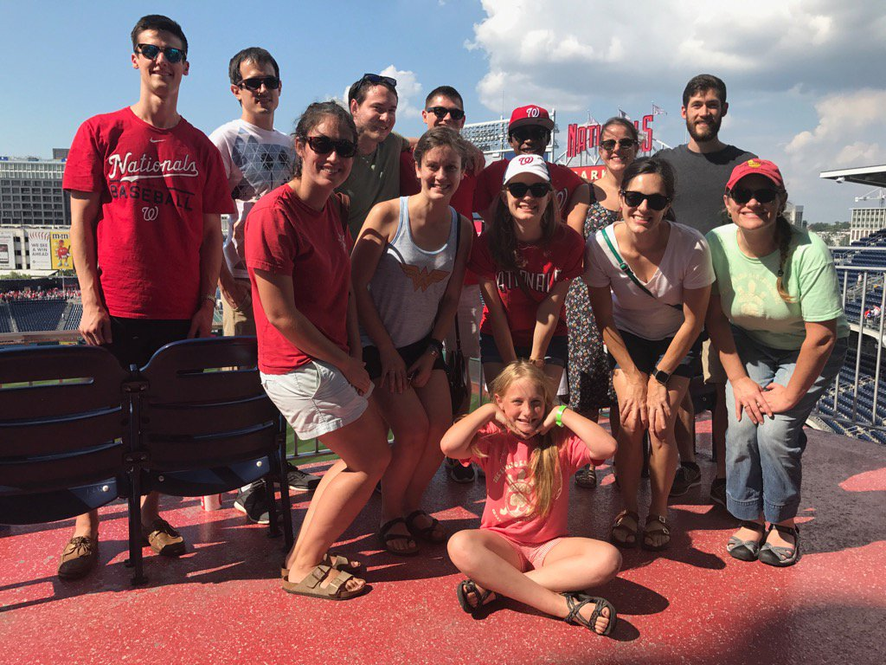
Acknowledgements
Papin Lab
Jason Papin
Glynis Kolling
Matthew Jenior
Deborah Luzader
Jennifer Bartell
Edik Blais
Phillip Yen
Maureen Carey
Anna Blazier
Kristopher Rawls
Bonnie Dougherty
Laura Dunphy
Thomas Moutinho
Dennis McDuffie
Imperial College London
Jonathan Swann
Natasa Giallourou
Mayo Clinic
Michael Mundy
UNC Chapel Hill
Luther Bartelt
UVA
Richard Guerrant
David Bolick
William Petri
Carol Gilchrist
Doctoral Committee
Kevin Janes (Chair)
Mete Civelek
Peter Kasson
William Petri
Funding
NIH R01GM108501 and T32GM008136
Wagner Pre-doctoral Fellowship

Slide 39

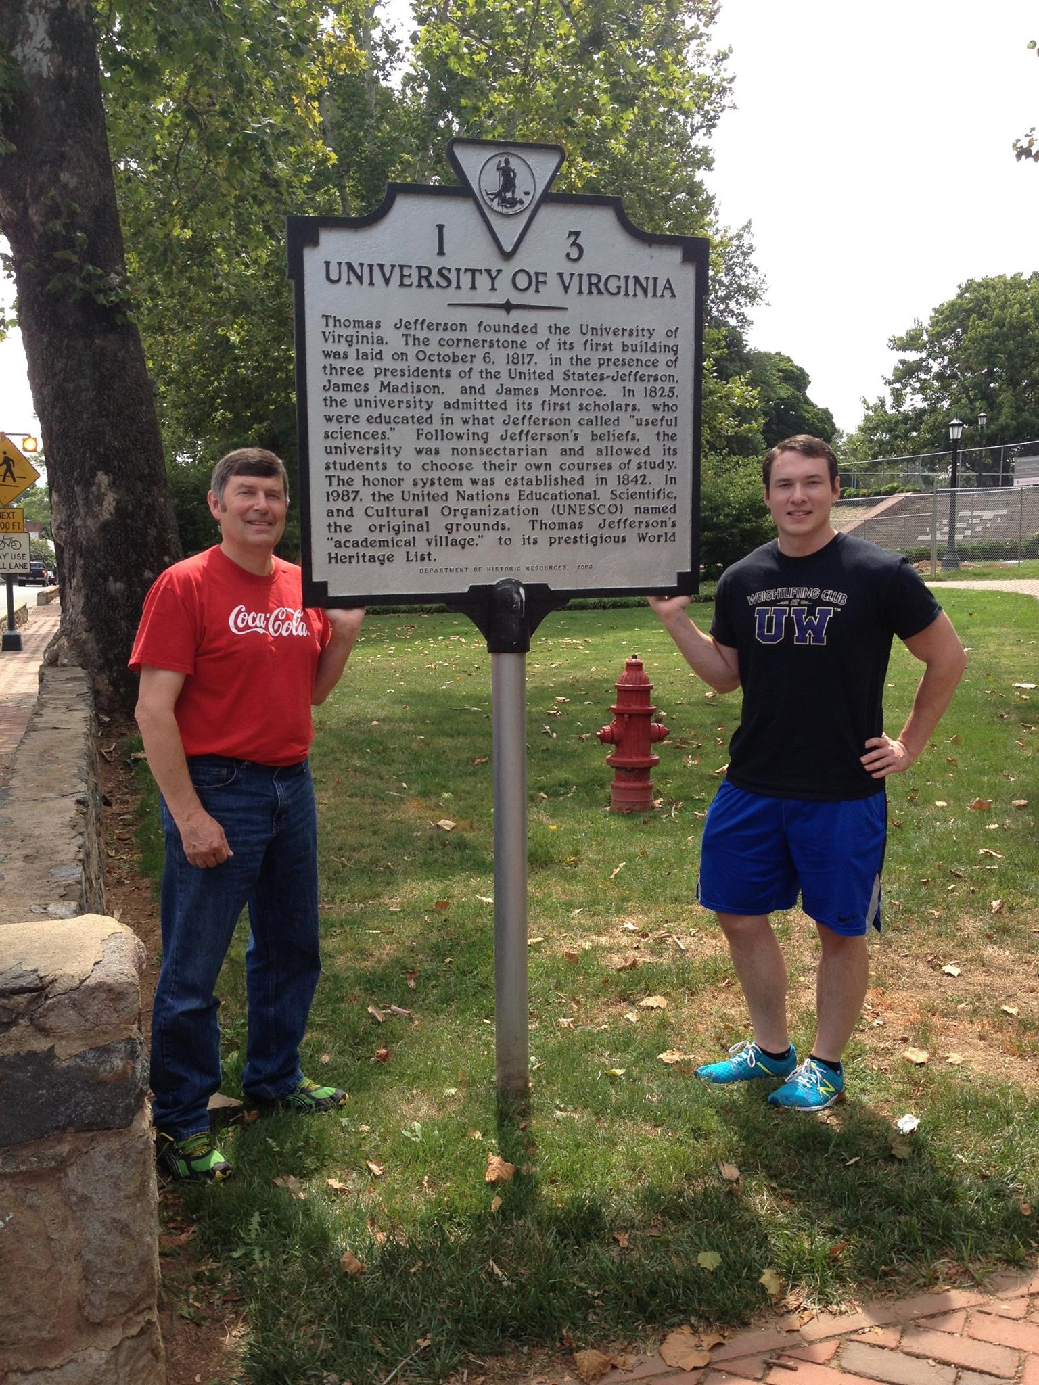
Notes:
Id like to dedicate this presentation to my Mom, who passed away after a fight with ovarian cancer during my first year in grad school . She was always my biggest cheerleader, and together with my Dad supported my interests unconditionally, even when it meant moving across the country to come to UVA. I love both of you and I’m so grateful for the loving environment you raised me in.

Slide 40



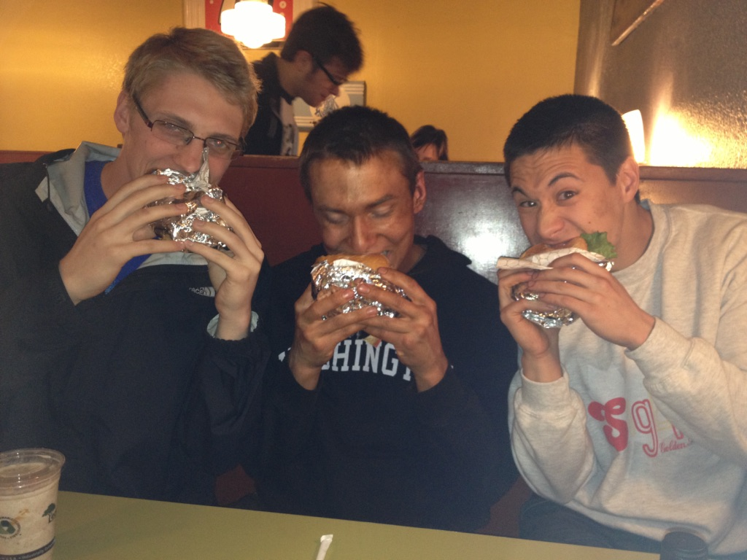
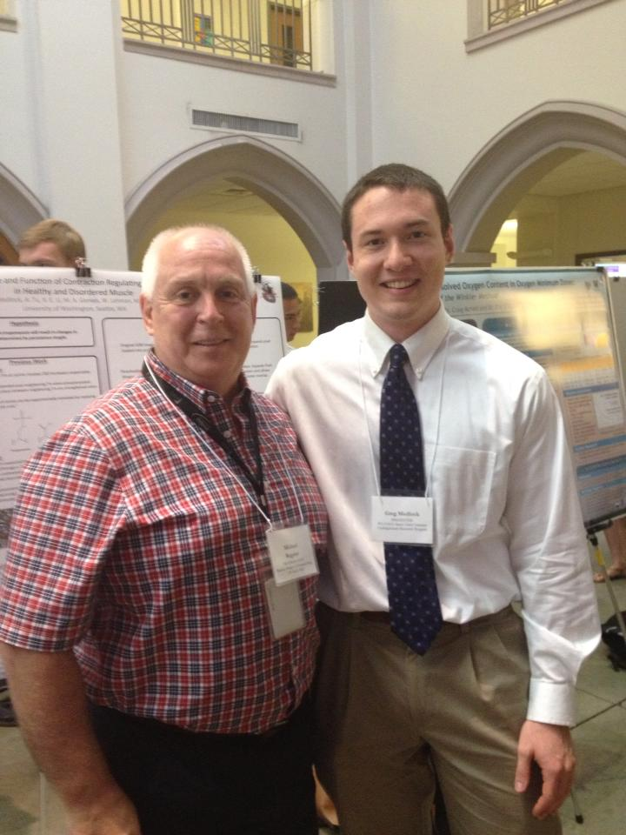

Notes:
I’ve had an incredible support system throughout my entire life. I was fortunate to grow up with 5 smart, thoughtful, and fun siblings. My friends and mentors helped me through all of the self-inflincted challenges I been fortunate enough to face, including college and dieting 20 weeks for a body building show (still the best burger I’ve ever had).

Slide 41



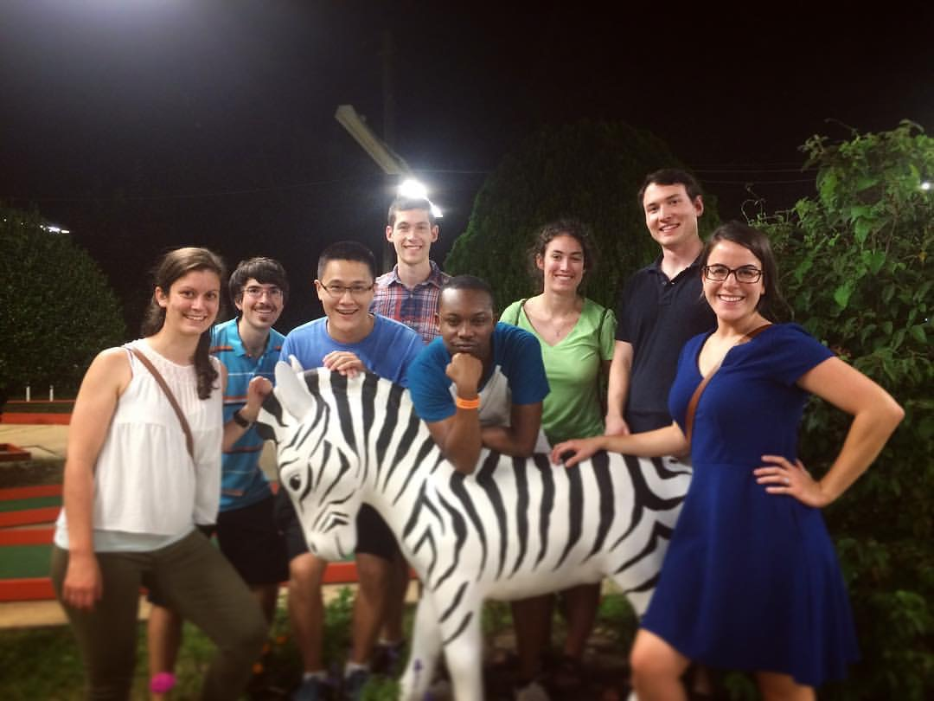
Notes:
This support has continued in Charlottesville, from everyone in Jason’s lab and the rest of BME to my gym friends and training partners that provide an oasis away from work.

Slide 42
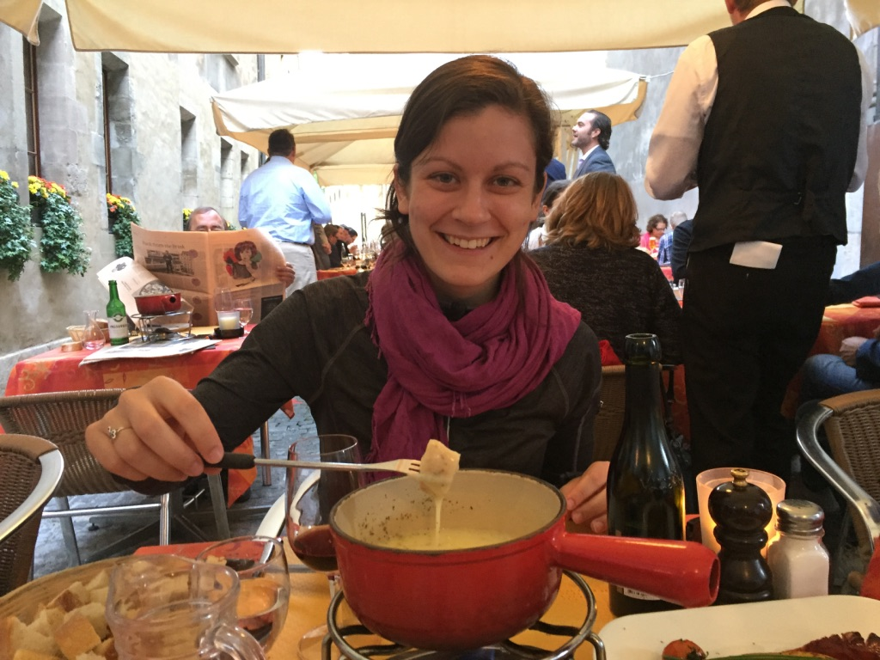
Notes:
Lastly, I want to thank my wife Maureen. This was the cheesiest photo I could find of her. You inspire me—I’m thankful for everything you do for me and with me, and I’m so proud of you.

Slide 43
Questions
Aim 1:
inferring metabolic interactions
between gut microbes
Aim 2:
Prioritize metabolic characterization of microbes

Slide 44
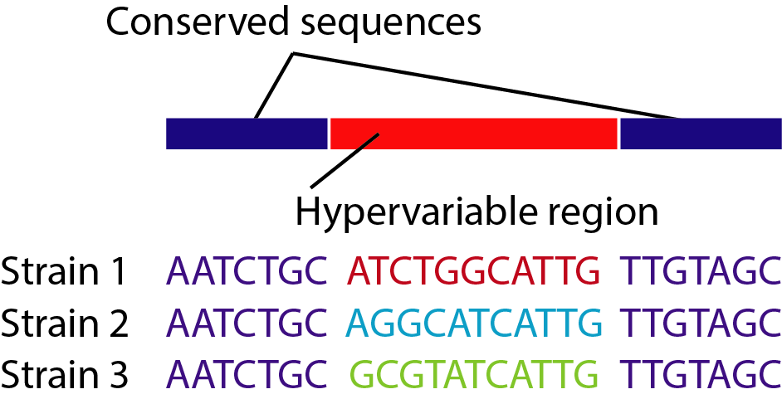
Classifying species with a single gene
Conserved gene
(e.g. 16S rRNA gene)
Can tell different species apart using similarity of sequences.
Can quantify the amount of each species based on amount of DNA with each sequence.
Background | Aim 1: metabolic interactions | Aim 2: metabolic capabilities | Conclusions

Slide 45
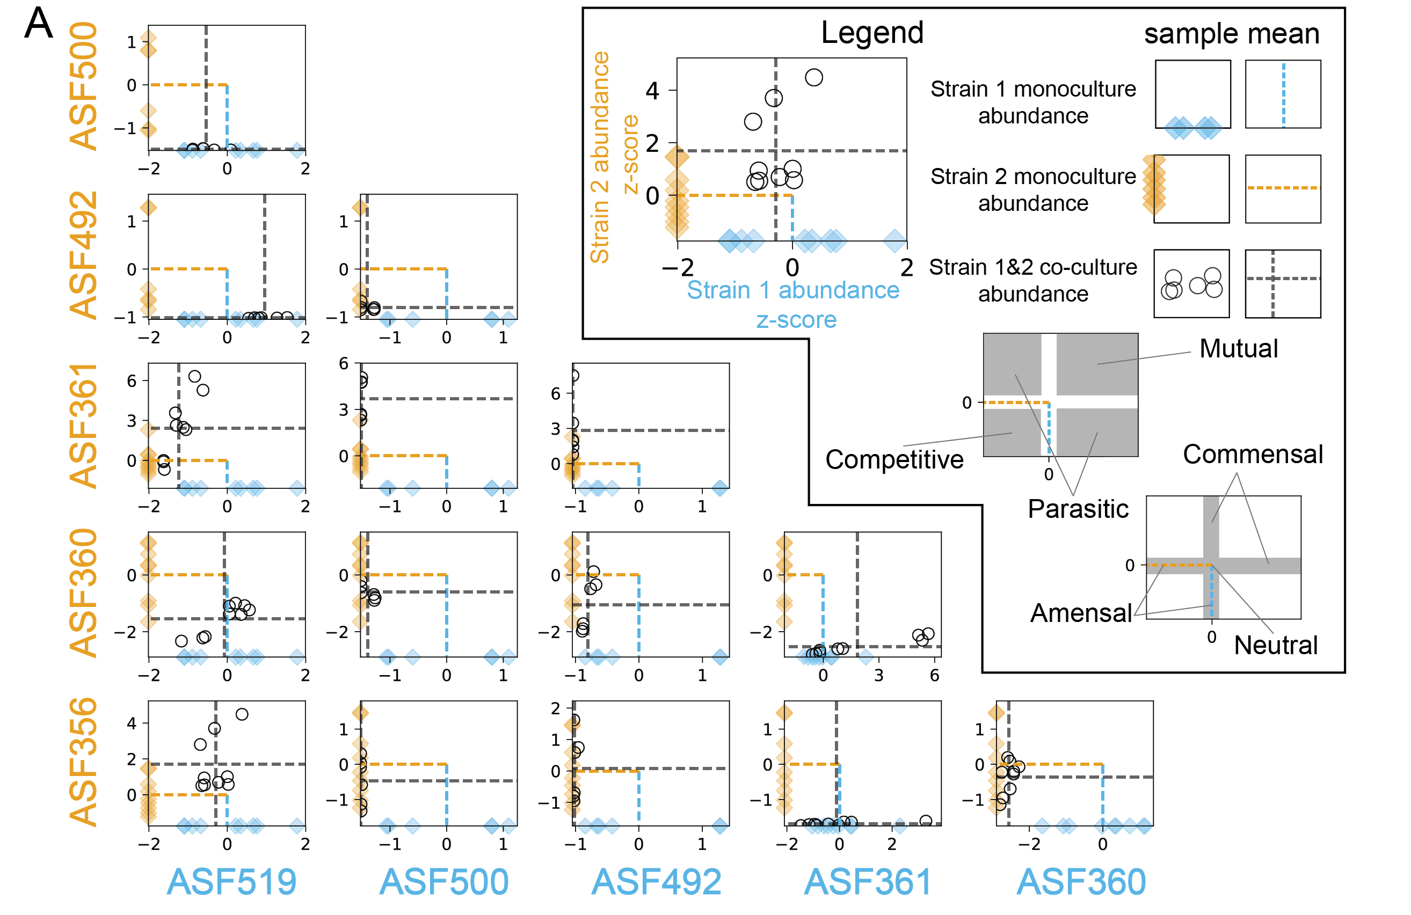
Medlock et al. Cell Systems 2018
Background | Aim 1: metabolic interactions | Aim 2: metabolic capabilities | Conclusions

Slide 46
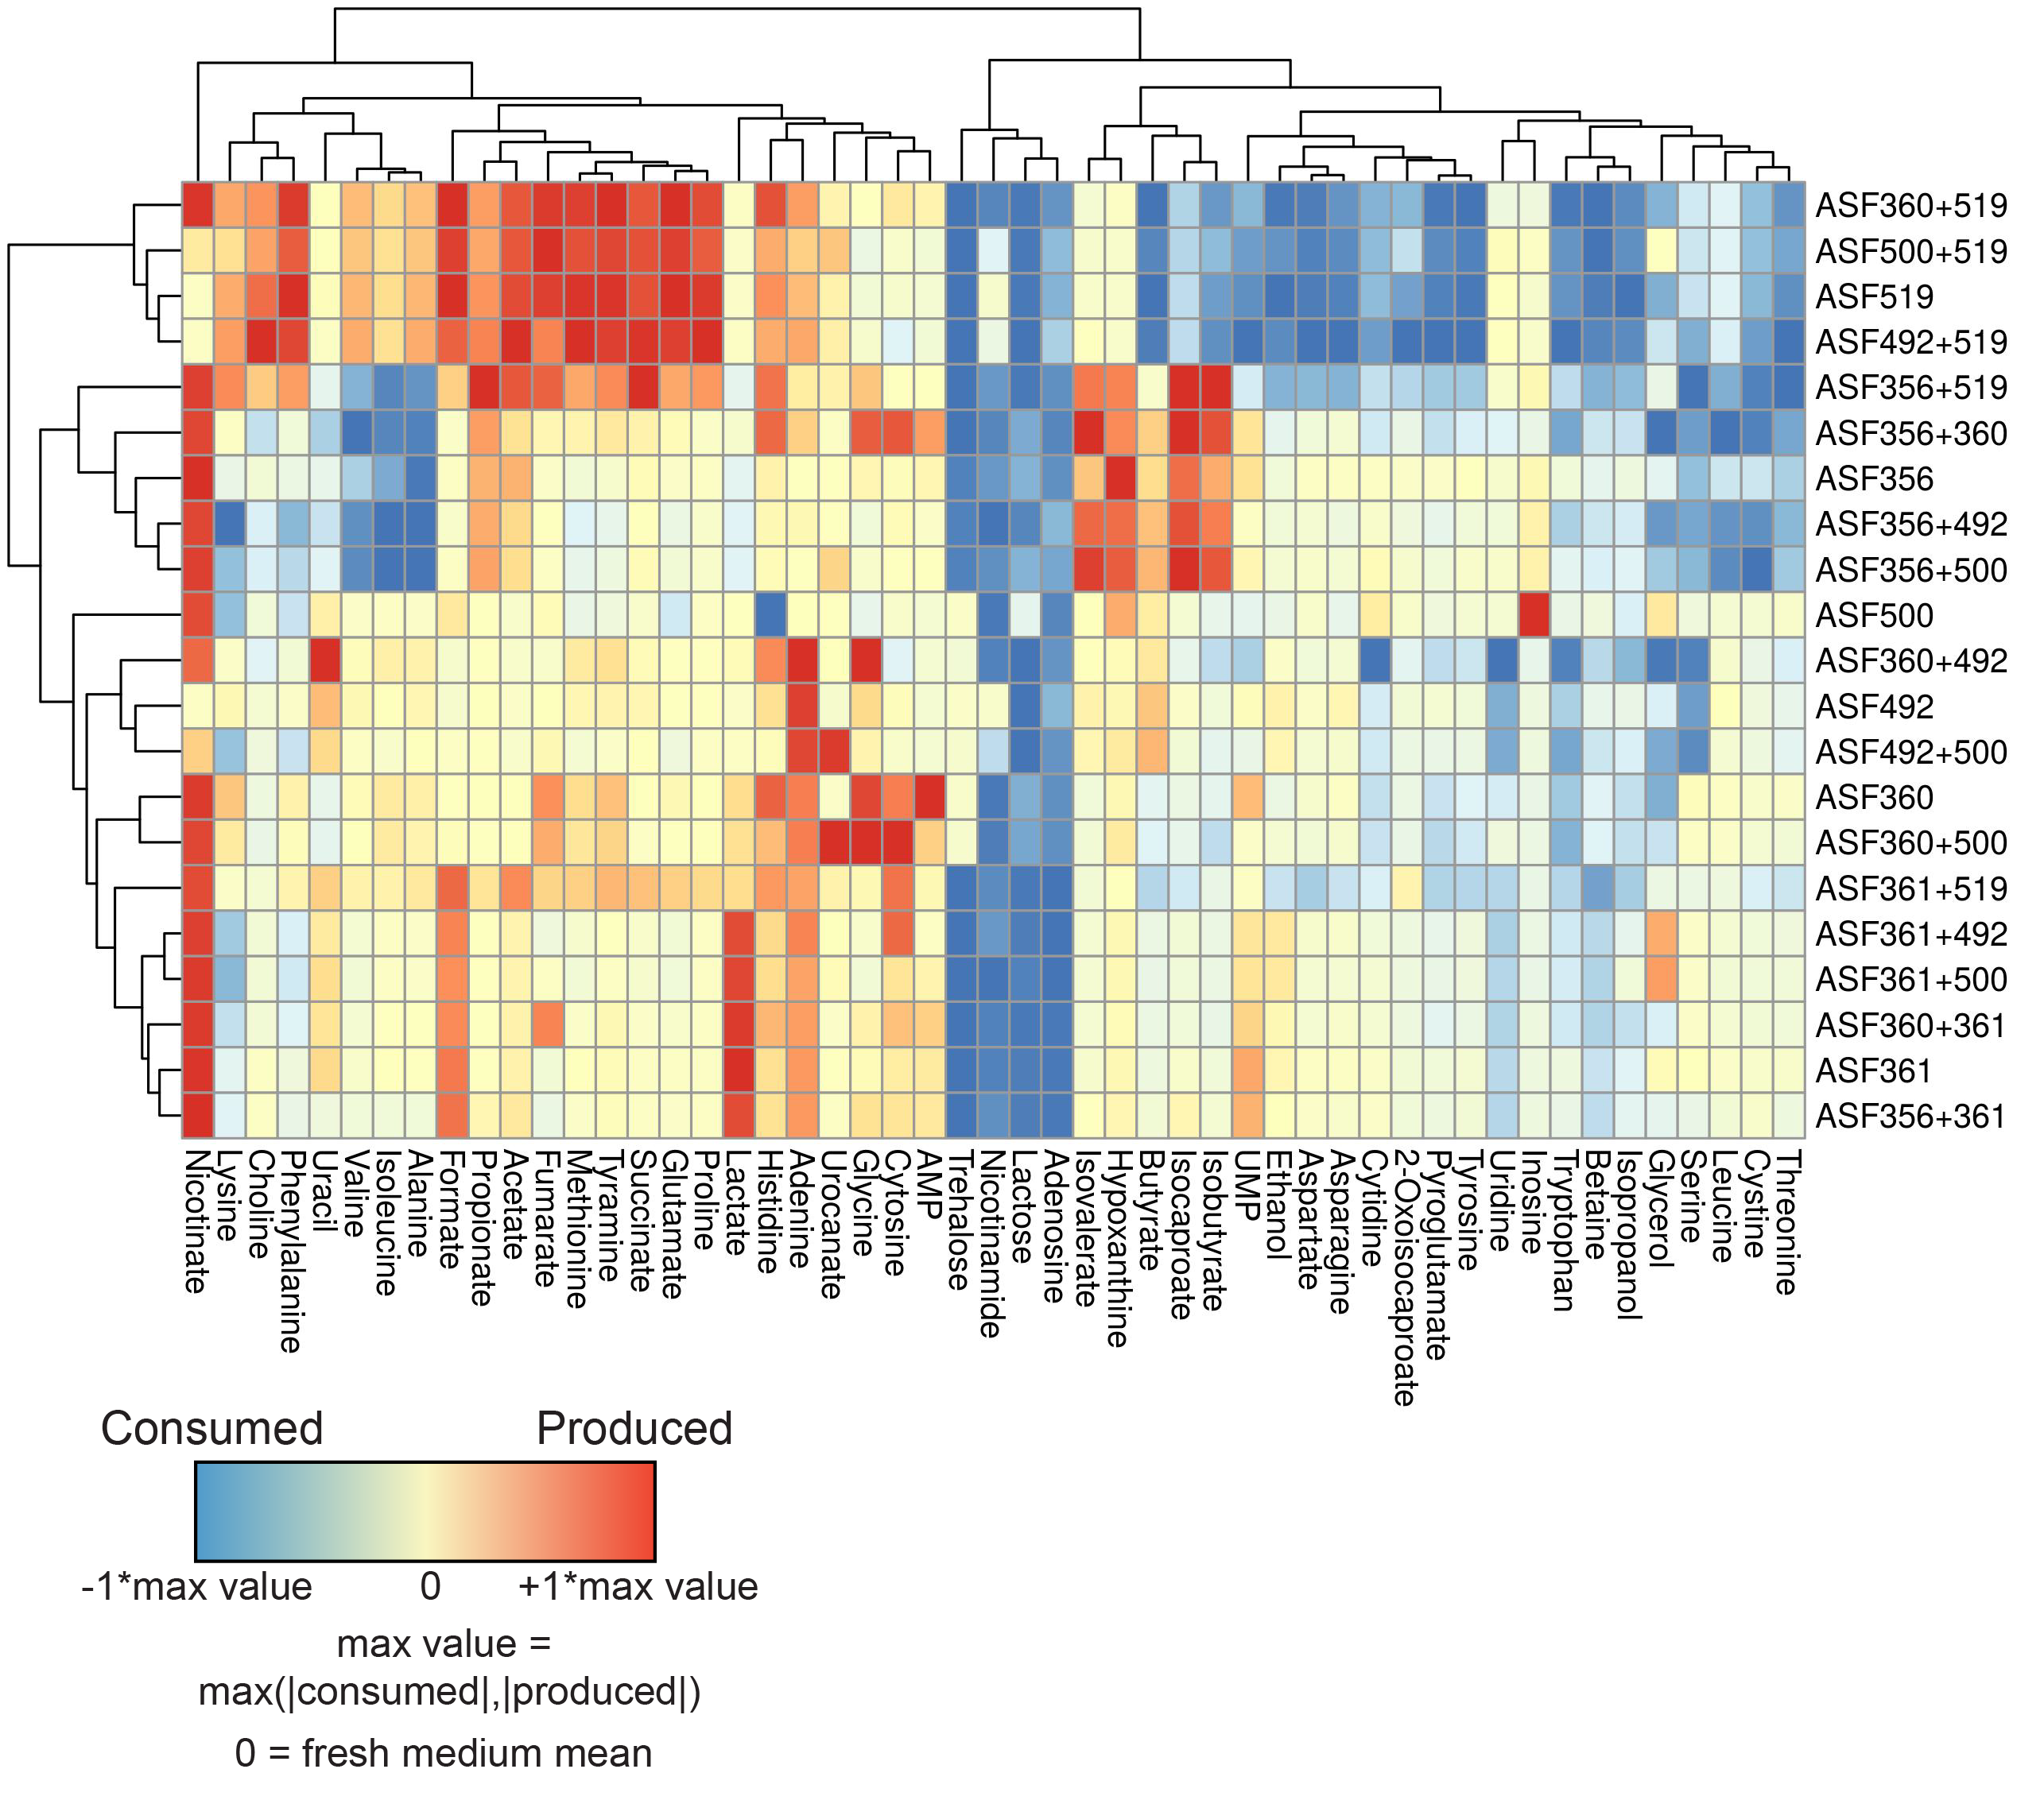
Medlock et al. Cell Systems 2018
Background | Aim 1: metabolic interactions | Aim 2: metabolic capabilities | Conclusions

Slide 47
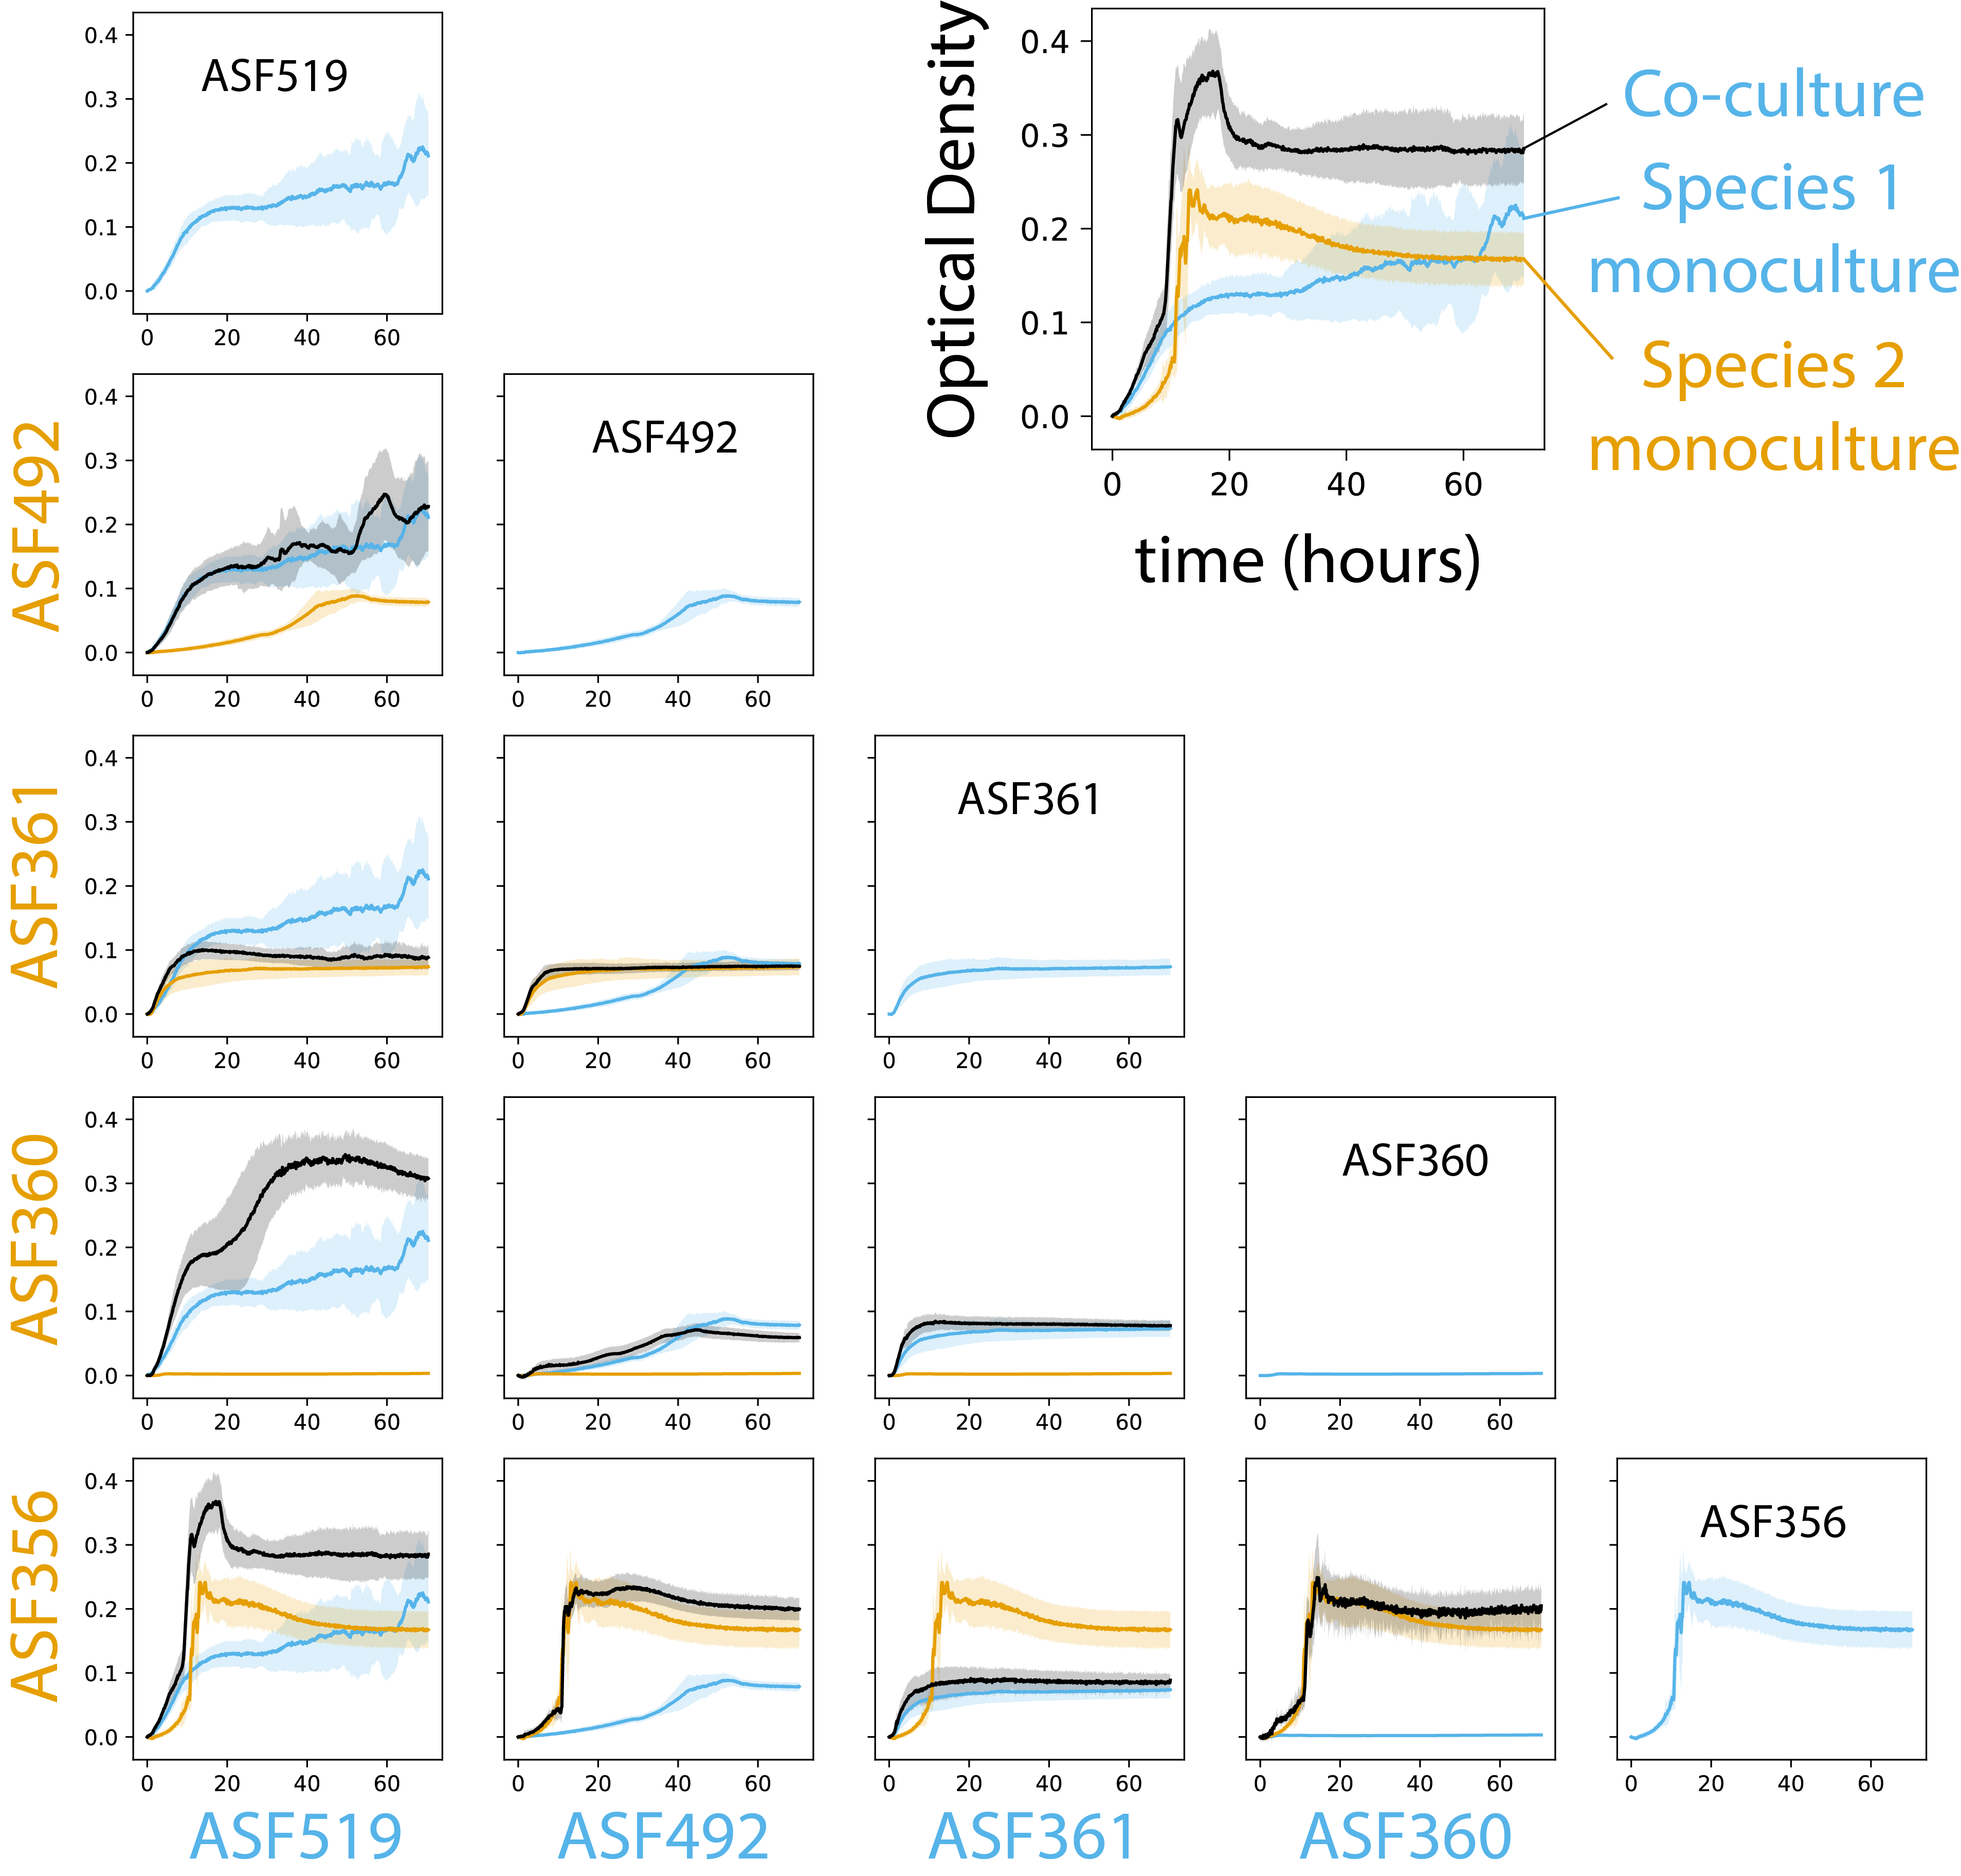
Medlock et al. Cell Systems 2018
Background | Aim 1: metabolic interactions | Aim 2: metabolic capabilities | Conclusions

Slide 48
Changes in species abundance confound interpretation of metabolomics data
Given a yield-based expectation:
Did co-culture enhance or decrease yield
of this metabolite?
Did co-culture lead to cross-feeding?
Medlock et al. Cell Systems 2018
Background | Aim 1: metabolic interactions | Aim 2: metabolic capabilities | Conclusions
Notes:
To see this, imagine we have a scenario in which one strain experiences a growth benefit, and another strain has no appreciable change. Both of these strains produced a particular metabolite in monoculture, at the relative amounts shown here, and each had approximately equal yields for this metabolite based on the amount produced per unit of strain biomass. In trying to infer whether the co-culture behavior was as expected for this metabolite, we must ask whether the abundance observed in co-culture matches our expectation. To create this expectation, we decided to assume that behavior in co-culture should be differential if the apparent yield of a metabolite changed in co-culture relative to the monoculture behavior. That is, one of the strains produced a larger or smaller quantity of a metabolite per unit biomass in co-culture than it did in monoculture.
Pull out abundance plot, replace with heatmap version

Slide 49
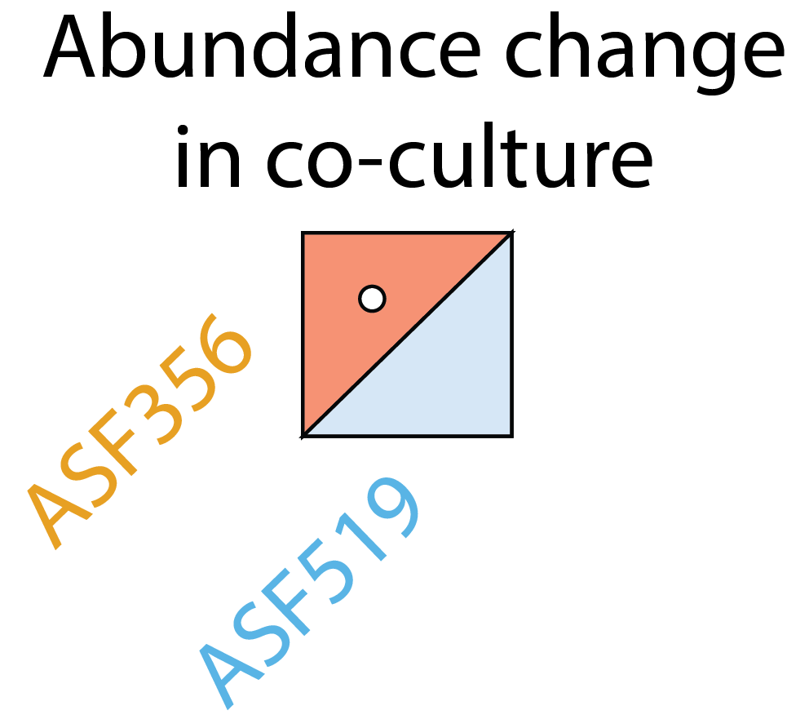
Putative cross-fed metabolites that improved growth of ASF356 co-cultured with ASF519
(ASF519)
(ASF356)
Decreasing
p-value
Less abundant
than expected
More abundant
than expected
Medlock et al. Cell Systems 2018
Background | Aim 1: metabolic interactions | Aim 2: metabolic capabilities | Conclusions

Slide 50
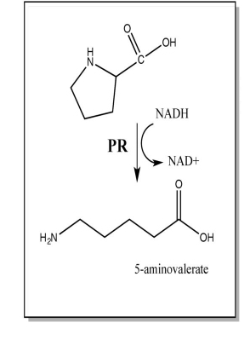
Putative cross-fed metabolites that improved growth of ASF356 co-cultured with ASF519
ASF356 belongs to the genus Clostridium, which are known to be highly proteolytic
Stickland fermentation: identified in 1934 in Clostridium sporogenes
Hypothesis: Proline and valine produced by ASF519 are used by ASF356 in Stickland fermentation
Decreasing
p-value
Proline reduction,
paired with oxidation of
alanine, isoleucine, or valine
Less abundant
than expected
More abundant
than expected
Medlock et al. Cell Systems 2018
Background | Aim 1: metabolic interactions | Aim 2: metabolic capabilities | Conclusions

Slide 51
Experimental support for Stickland fermentation of proline by ASF356
Increased growth from supplementation of a Stickland pair, but not individual metabolites, suggests Stickland fermentation facilitates growth of ASF356
Medlock et al. Cell Systems 2018
Background | Aim 1: metabolic interactions | Aim 2: metabolic capabilities | Conclusions

Slide 52
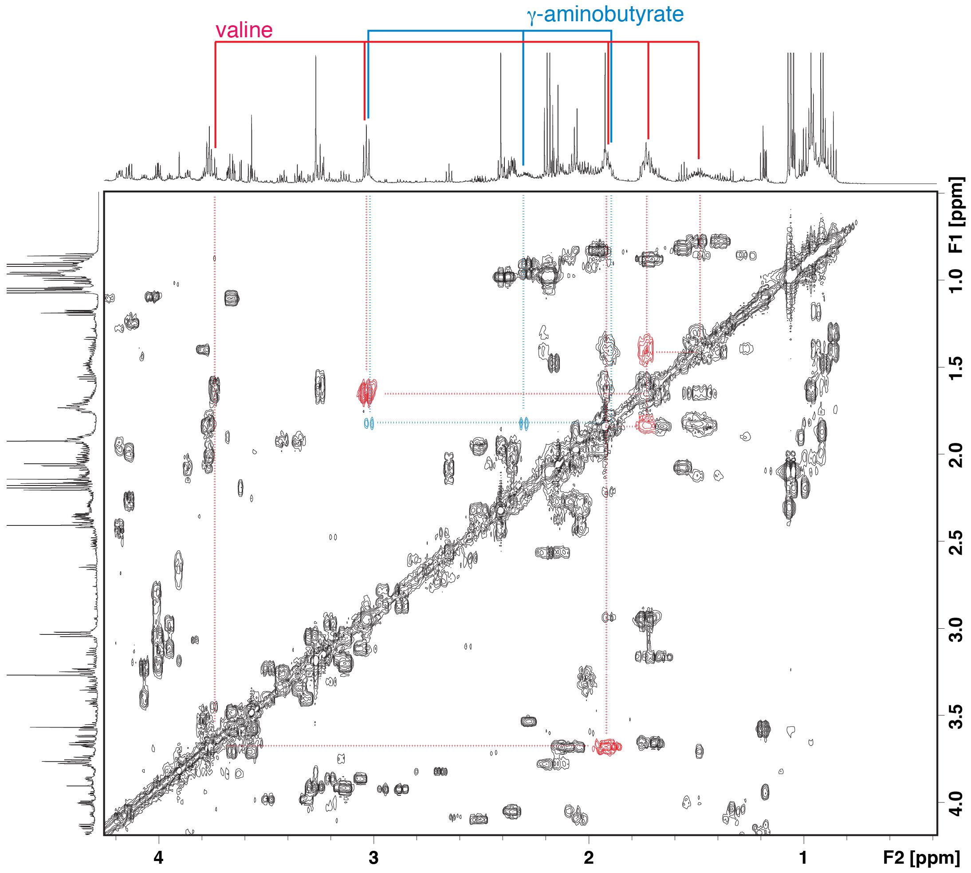
Where are the Stickland fermentation products?
5-aminovalerate, the product of proline reduction, overlaps with other metabolites within the NMR spectra.
We attempted identification of 5-aminovalerate in ASF356-ASF519 co-culture using 2D-NMR
The signal we thought might be 5-aminovalerate was actually gamma-aminobutyrate (AKA the neurotransmitter GABA)
Alternative hypotheses: 1) 5-aminovalerate is further degraded, or 2) Pro-Ala synergy is not due to Stickland fermentation
Medlock et al. Cell Systems 2018
Background | Aim 1: metabolic interactions | Aim 2: metabolic capabilities | Conclusions

Slide 53
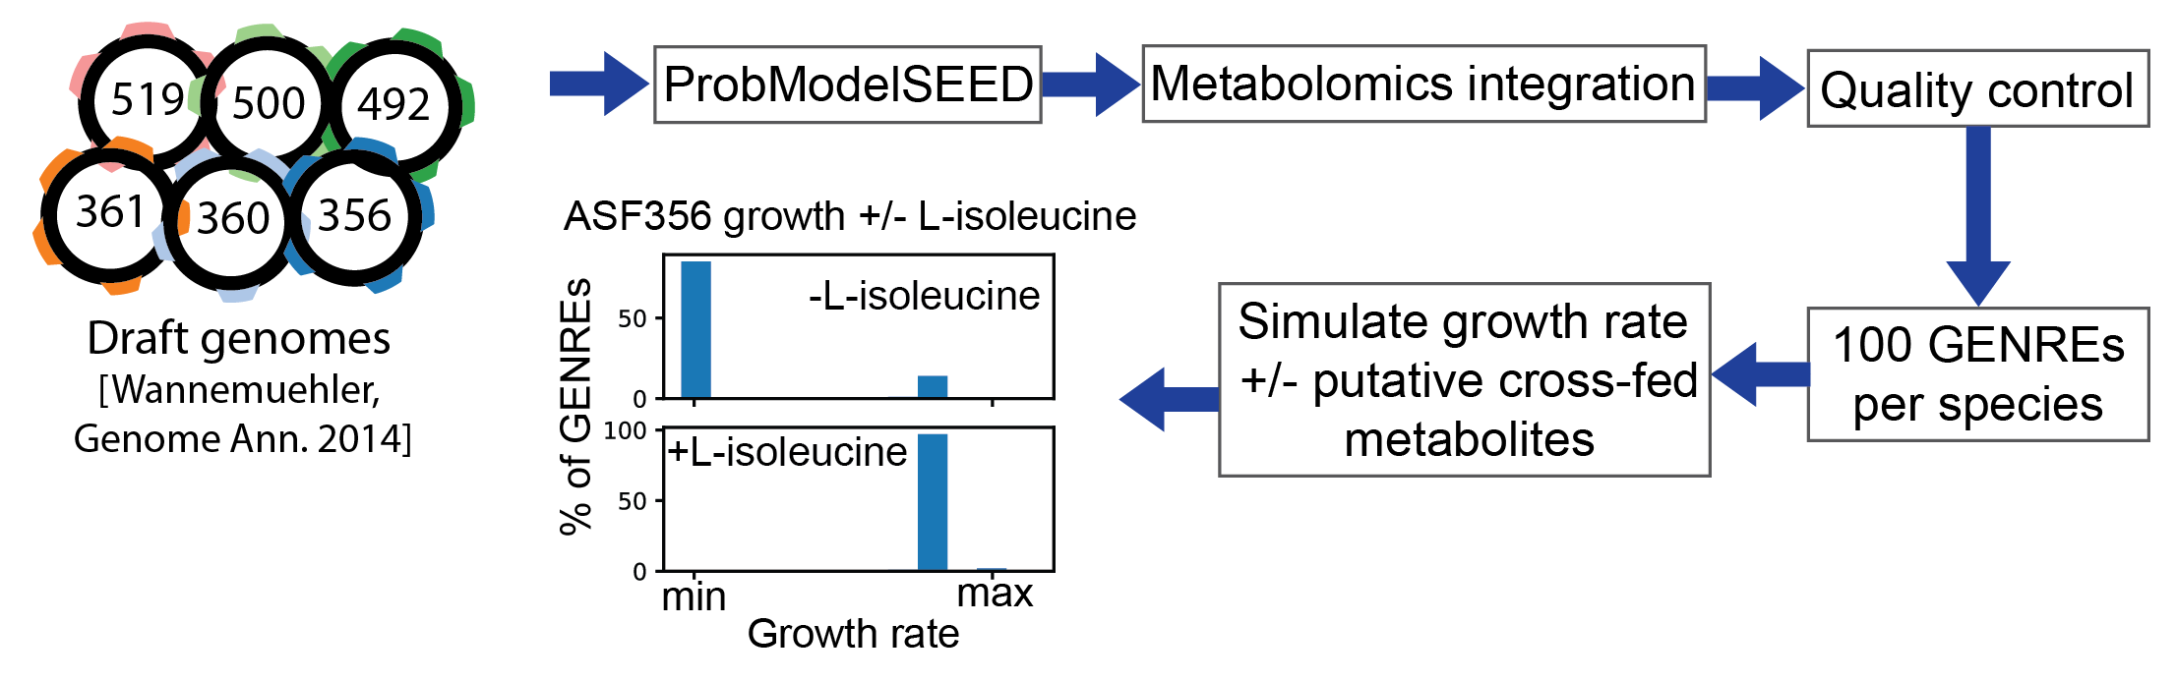
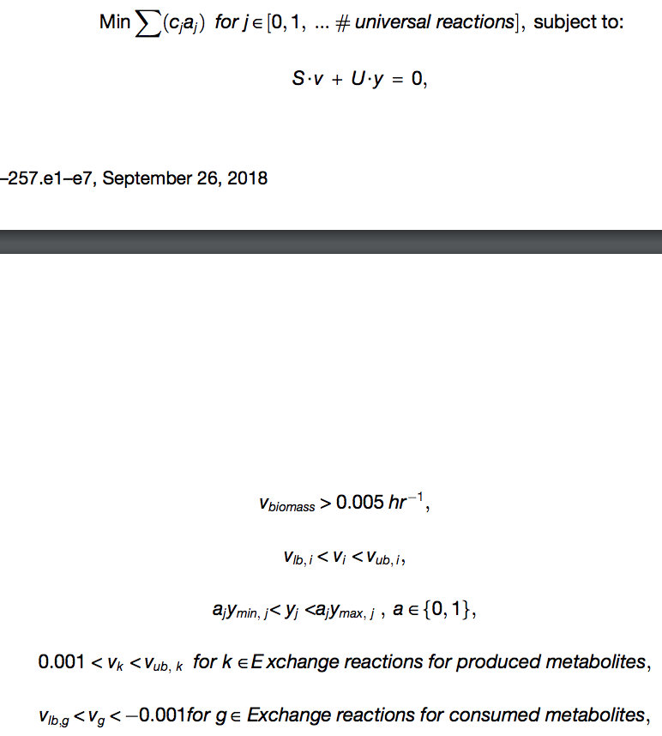
Notes:
One modeling strategy that is promising is genome-scale metabolic modeling. In genome-scale metabolic modeling, an organisms' genome is annotated with biochemical functions. Then, these annotations are assembled into a genome-scale metabolic network reconstruction, or GENRE, where the biochemical functions are connected to each other. This GENRE can then be represented mathematically, forming a stoichiometric matrix that allows numerical methods to be applied to the system. In practice, objective functions are also defined, such as production of biomass from metabolic precursors, in order to simulate biological objectives, such as maximizing growth. Numerical optimization can then be applied to model this maximization of a biological objective and find the network states, in this case reaction fluxes, that allow that maximum value to occur.
GENREs are well-suited to study gut microbes because they take environmental context into account. Just as the environment within the human gut is constantly changing as a function of diet, the metabolites available for uptake for an organism can be precisely controlled with a GENRE. GENREs also allow explicit modeling of interactions between species. Various methods have been developed to simulate these interactions, however none have been validated. The last primary benefit of using a GENRE to study gut microbes is that they provide a platform to accelerate the discovery of genes of unknown function. When data are collected, they can be compared to in silico predictions, and the GENRE can be used to evaluate whether putative novel functions improve the concordance of the GENRE with the observations collected.

Slide 54
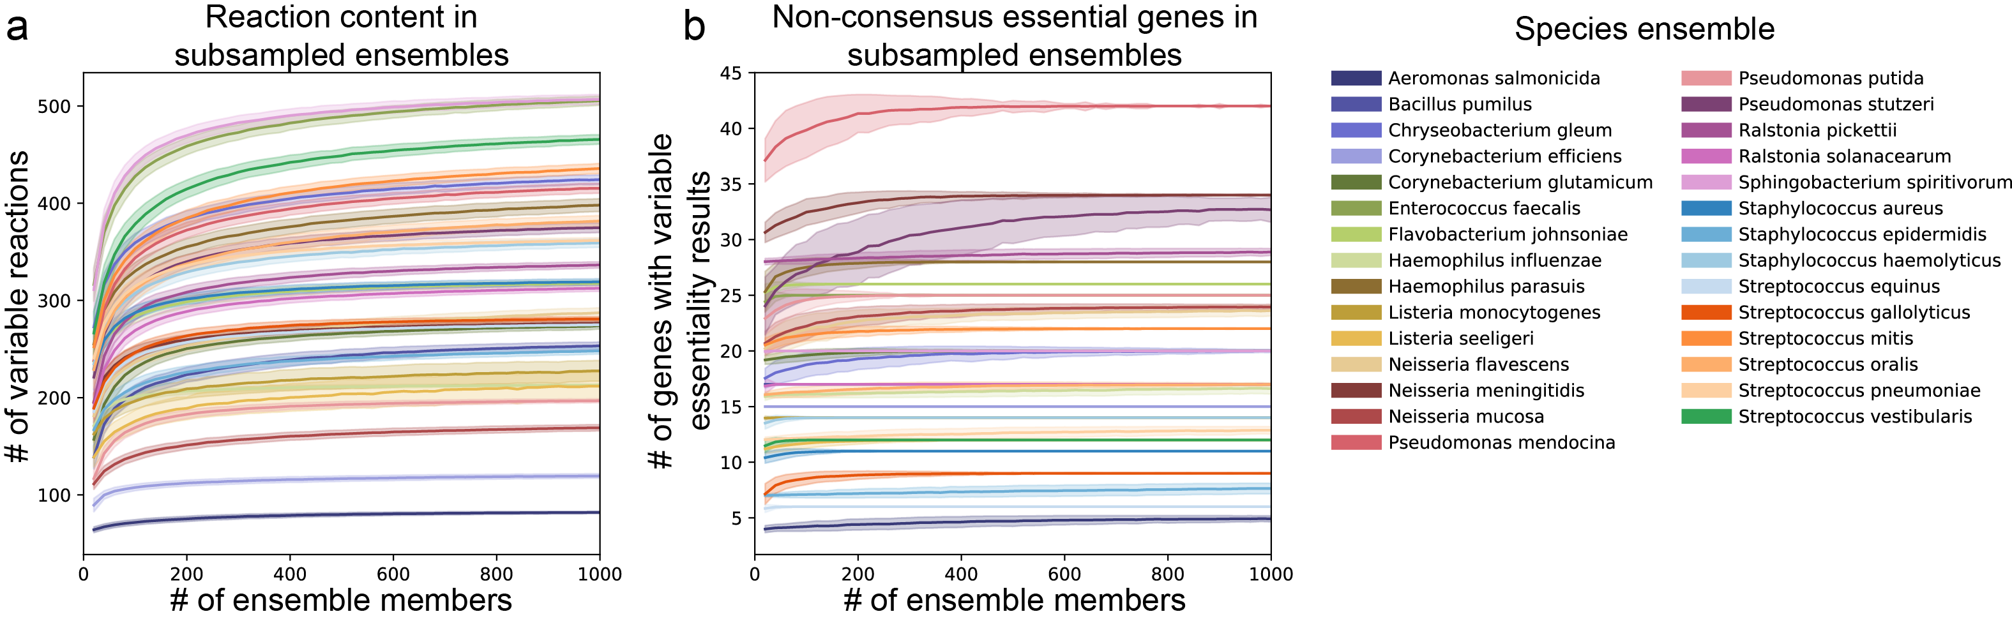
Gapfilling data: Plata et al., Nature 2015
Background | Aim 1: metabolic interactions | Aim 2: metabolic capabilities | Conclusions

Slide 55
Background | Aim 1: metabolic interactions | Aim 2: metabolic capabilities | Conclusions

Slide 56
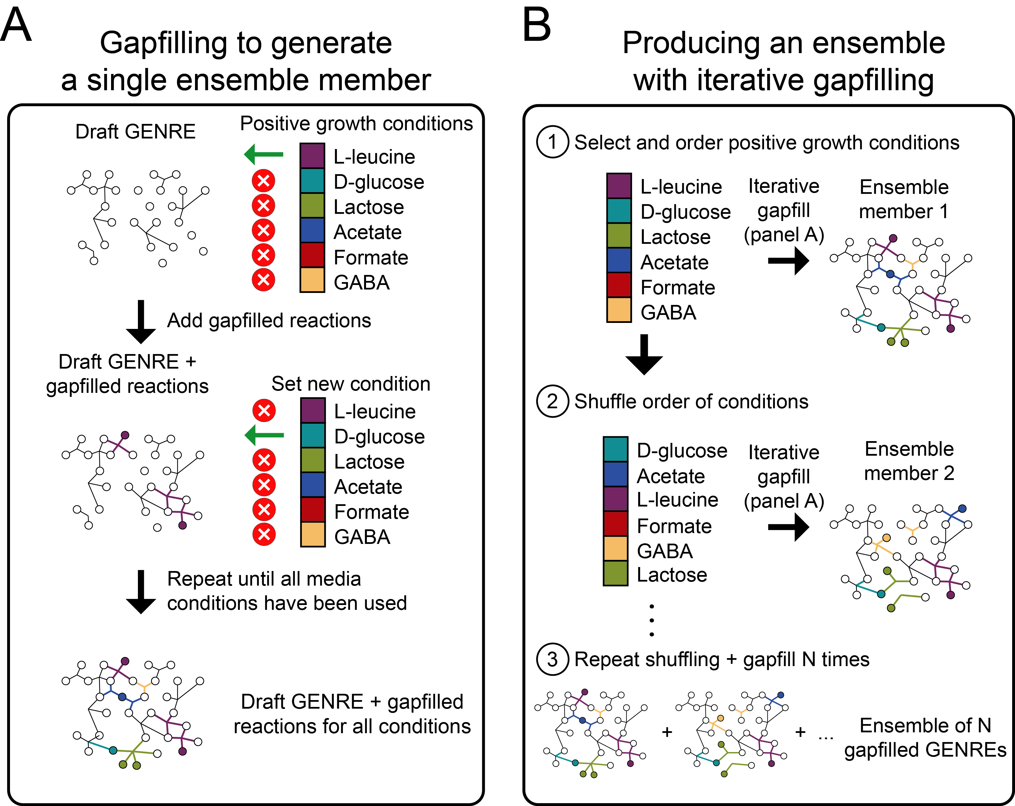
Background | Aim 1: metabolic interactions | Aim 2: metabolic capabilities | Conclusions

Slide 57
Does this process make models more accurate?
Compared predictive abilities of each simulation cluster against experimental data
Selecting one cluster of models improves performance
Background | Aim 1: metabolic interactions | Aim 2: metabolic capabilities | Conclusions

Slide 58
Genome-scale metabolic network reconstructions (GENREs)
GENREs are well suited for studying gut microbes because:
They take environmental context into account
They allow modeling of interactions between species
They can be constructed from sequence data alone (i.e. clinical + in vivo relevance)
Background | Aim 1: metabolic interactions | Aim 2: metabolic capabilities | Conclusions
Notes:
One modeling strategy that is promising is genome-scale metabolic modeling. In genome-scale metabolic modeling, an organisms' genome is annotated with biochemical functions. Then, these annotations are assembled into a genome-scale metabolic network reconstruction, or GENRE, where the biochemical functions are connected to each other. This GENRE can then be represented mathematically, forming a stoichiometric matrix that allows numerical methods to be applied to the system. In practice, objective functions are also defined, such as production of biomass from metabolic precursors, in order to simulate biological objectives, such as maximizing growth. Numerical optimization can then be applied to model this maximization of a biological objective and find the network states, in this case reaction fluxes, that allow that maximum value to occur.
GENREs are well-suited to study gut microbes because they take environmental context into account. Just as the environment within the human gut is constantly changing as a function of diet, the metabolites available for uptake for an organism can be precisely controlled with a GENRE. GENREs also allow explicit modeling of interactions between species. Various methods have been developed to simulate these interactions, however none have been validated. The last primary benefit of using a GENRE to study gut microbes is that they provide a platform to accelerate the discovery of genes of unknown function. When data are collected, they can be compared to in silico predictions, and the GENRE can be used to evaluate whether putative novel functions improve the concordance of the GENRE with the observations collected.

